Slide 1
Life Sciences Flourish in Ontario, Canada

Slide 2
Life Sciences Flourish in Ontario, Canada
LIFE SCIENCES
IN ONTARIO, CANADA: THRIVING IN A POST-SECTOR ERA
Ontario, Canada is at the forefront of sweeping change in the global health and life sciences sector—and we want you to be a part of our dynamic ecosystem.
From medical technologies, genomics and artificial intelligence to biotechnology, advanced manufacturing, pharmaceuticals and the Internet of Things, where formerly isolated sectors converge, the possibilities for your business are endless. This cross-sector pollination has the potential to produce discoveries and solutions we can scarcely imagine today.
Organizations with an eye on the future know that this dramatic shift in the way we collaborate is paving the way for a whole new era of life sciences innovation—deemed by some of the biggest minds in the business as the “post-sector” era.
In this post-sector era, a company’s biggest asset is its talent. That’s why, to position themselves for success, businesses that are thinking ahead are basing themselves in places that offer a highly skilled workforce focused on building a culture of innovation. Coupled with an ecosystem ready to supply incentives, connections and mentorship opportunities, Ontario has what your business needs to compete at the highest levels.
There’s a reason why global giants like Amgen, Genzyme, Johnson & Johnson, Sanofi and Roche have chosen to grow their business in the province.
In Ontario, we understand not just the potential before us, but also the challenges facing your company in today’s global economy and how to best meet those challenges head-on.
Ontario is where life sciences thrive.
All figures are in Canadian dollars (CAD) unless otherwise stated. The information in this book is accurate at the time of publication.
© Queen’s Printer for Ontario, 2022

Slide 3
$53B
10
LOWER
in annual revenues, exporting $9.9B in products
of the world’s top pharmaceutical companies by revenue
corporate income tax rate than average among G7 and G20 countries
1,900
1,300
23
2ND
LIFE SCIENCES FIRMS, EMPLOYING MORE THAN 68,000 PEOPLE
medical device manufacturing firms
academic research hospitals
largest IT cluster in North America

Slide 4
I think the biggest asset Ontario provides to companies like us is its deep talent pool. We have been very impressed with the quality of people we have hired locally for the site, and I think this reflects the fact that the province does wonderful research.
RONNIE MILLER
PRESIDENT & CEO ROCHE CANADA

Slide 5
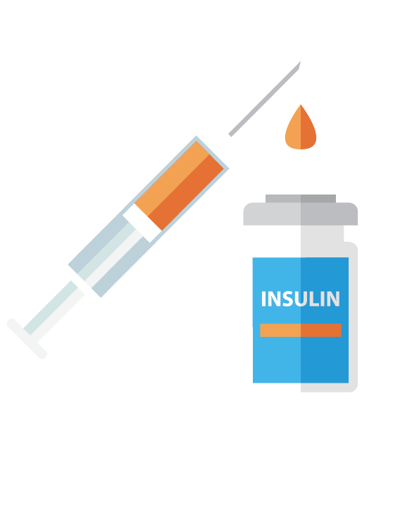
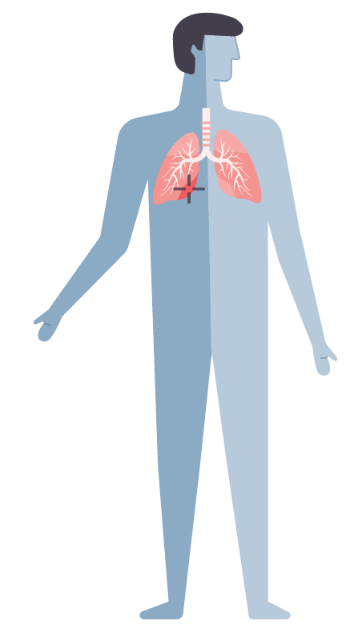
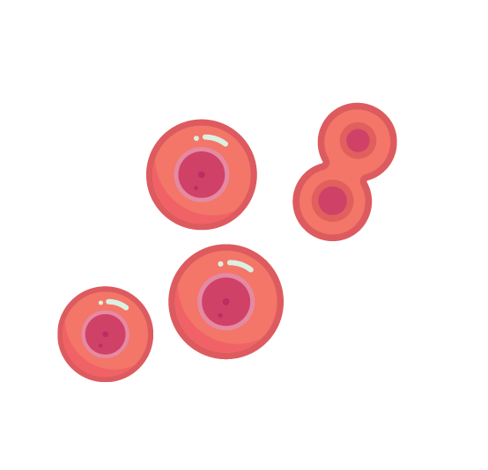
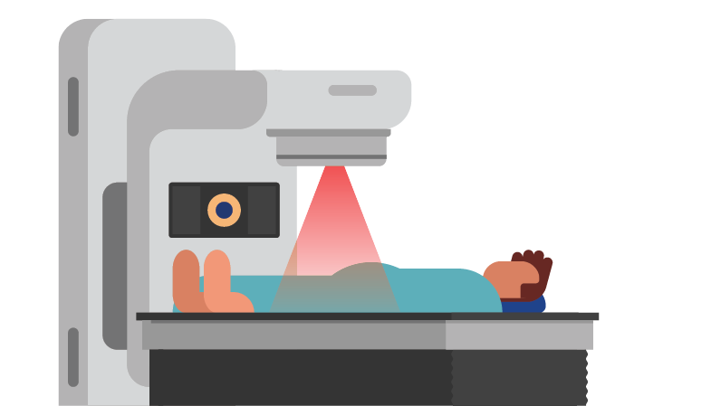
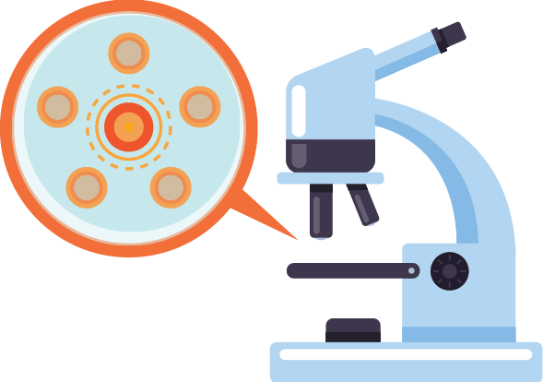
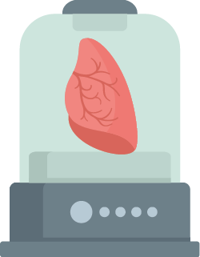
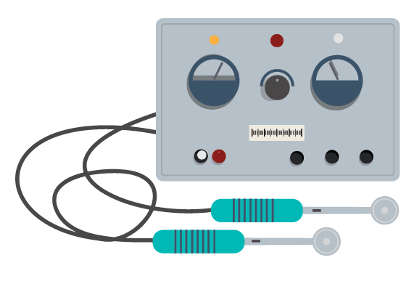
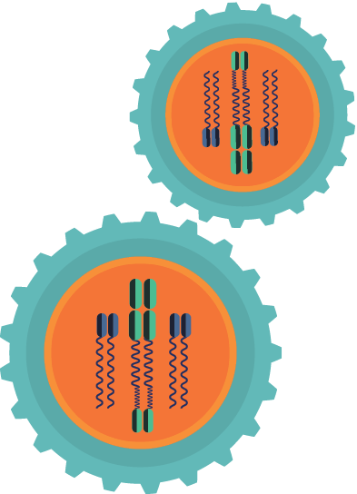
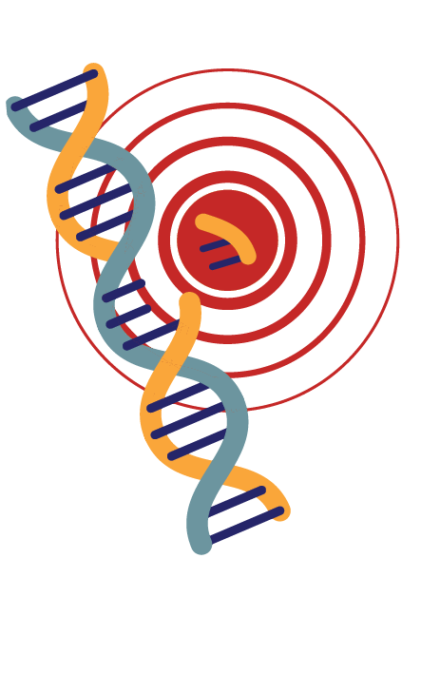
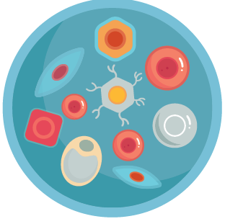
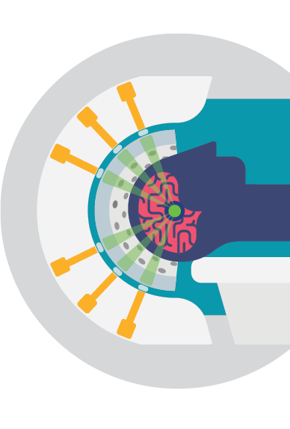
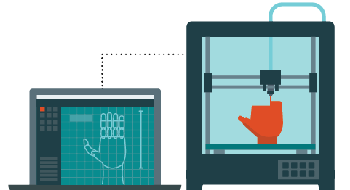
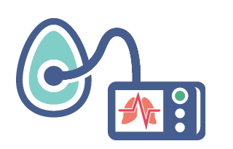
1ST REMOTE ROBOTIC SURGERY
GENE FOR BREAST CANCER
GENE FOR EPILEPSY
DOPAMINE D1, D2, D4, D5 RECEPTORS
GENE FOR CYSTIC FIBROSIS
SH2 DOMAIN
1ST HIGH-RESOLUTION ELECTRON MICROSCOP
GAME CHANGERS: ONTARIO HAS SHAPED
THE FIELD OF LIFE SCIENCES
Other Notable Discoveries
1921
Discovery of insulin
1983
Successful lung transplant
1999
1st artificial cornea
2017
XVIVO Perfusion system to preserve organs outside the body for transplant
2013
1st use of novel approach to treat localized prostate cancer
1952
World’s 1st electric wheelchair for quadriplegics
1994
1st cancer stem cell discovery
2009
Viral-free iPS cell
1950
1st pacemaker
1984
Cloning of 1st T-cell receptor
2001
Discovery of the pain genes
2016
Discovery of method to boost stem cell self-renewal
2017
Opening a window into the brain with focused ultrasound
1963
Stem cell discovery
1995
Identified Alzheimer’s gene
2012
Prototype of a 3D bioprinter to print artificial skin for burn victims
2016
Living without lungs—helping patients survive the wait for a transplant

Slide 6
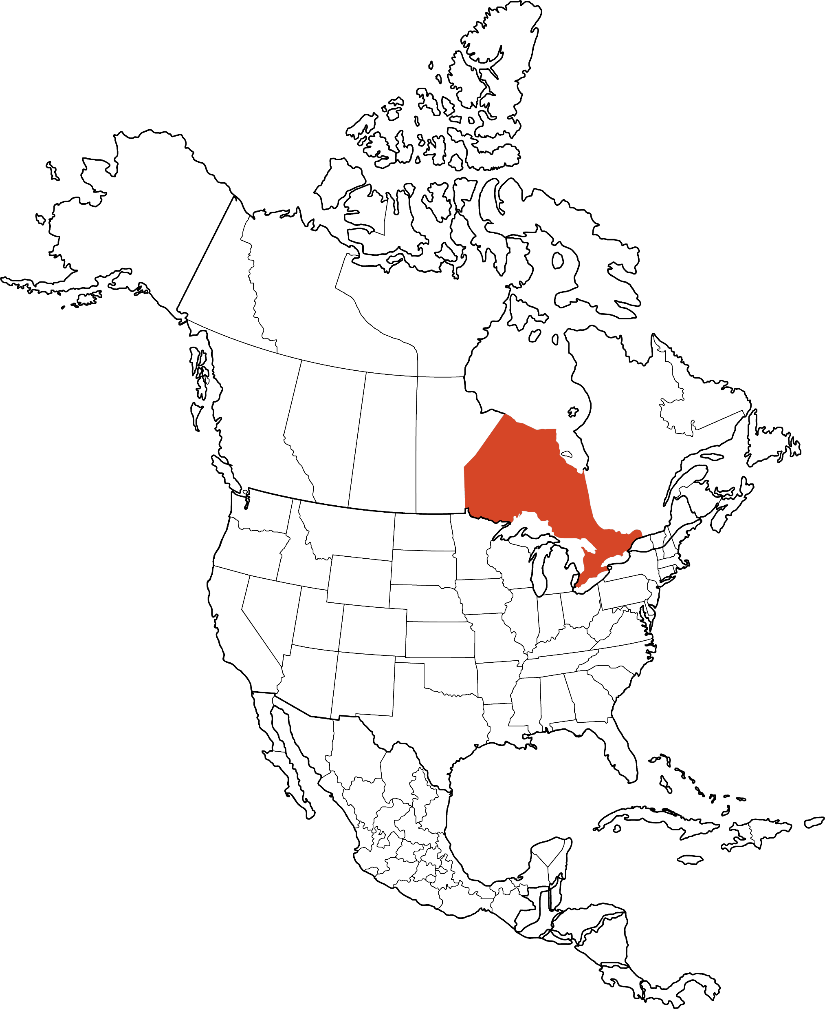
WHY LIFE SCIENCES FIRMS CHOOSE ONTARIO
THUNDER BAY
Life Sciences Clusters in Ontario
SUDBURY
NORTH BAY
OTTAWA
Ontario’s strengths lie in our major technology clusters, many of which focus on pharmaceutical and medical technology breakthroughs. We are at the forefront of understanding and promoting life sciences’ interaction with genomics, artificial intelligence, biotechnology, automation and the Internet of Things.
By locating in Ontario, your business will benefit from a diverse life sciences sector, collaborative spirit and a deep talent pool—all of which are creating medical innovations that will improve health care delivery around the globe.
Whether you want to expand your operations here or purchase some of the highest quality medical products in the world, Ontario is your life sciences destination.
MISSISSAUGA
TORONTO
WATERLOO
HAMILTON
LONDON
WINDSOR

Slide 7
WHY LIFE SCIENCES FIRMS CHOOSE ONTARIO
ONTARIO’S TRADE AND INVESTMENT OFFICES ARE LOCATED AROUND THE WORLD
WITH HEADQUARTERS IN TORONTO
1,200 km ( 750 miles )
800 km ( 500 miles )
400 km ( 250 miles )
LONDON
CHICAGO
NEW YORK
PARIS
MUNICH
BEIJING
SAN FRANCISCO
WASHINGTON D.C.
SEOUL
TOKYO
DALLAS
SHANGHAI
NEW DELHI
CHONGQING
MEXICO CITY
MUMBAI
ACCESS TO CONSUMERS
187 million consumers within a day’s drive of the Greater Toronto Area

Slide 8
WHY LIFE SCIENCES FIRMS CHOOSE ONTARIO
WORLD-CLASS STRENGTHS
ONCOLOGY
CARDIOLOGY
NEUROSCIENCE
STEM CELL R&D AND REGENERATIVE MEDICINE
DIAGNOSTIC IMAGING
POINT OF CARE TESTING
ADVANCED MANUFACTURING

Slide 9
ONTARIO IS A PHARMACEUTICAL
GIANT
Ontario has a long history of quality pharmaceutical manufacturing, both with global companies like Sanofi Pasteur and domestic players like Apotex—and we want you to be a part of our collective future.
The size of our ecosystem proves that quantity and quality can work in tandem to produce results. The numbers speak for themselves—more than 320 pharmaceutical firms call Ontario home, employing about 32,000 people and making up the country’s largest pharmaceutical workforce. In 2018, the province’s life sciences sector generated more than $40 billion in revenue and over $7.5 billion in exports—accounting for more than half of Canada’s pharmaceutical revenue. And in Ontario, you’ll have access to an ecosystem that ranks in the top ten in North America for number of pharmaceutical establishments and employment.
But the most impressive part of the sector? The work our companies are doing to transform today’s scientific discoveries into tomorrow’s breakthrough health care solutions. For example, Winterlight Labs has developed an AI-driven digital biomarker to diagnose early-stage Alzheimer’s disease using just two minutes of speech. Through its JLABS residency, the company is collaborating with Janssen Pharmaceuticals to commercialize its technology in Canada and beyond.

Slide 10
ONTARIO IS A PHARMACEUTICAL
GIANT
PHARMA BY THE NUMBERS
320
$40.6B
$7.5B
31,800
PHARMACEUTICAL FIRMS (7TH IN NORTH AMERICA)
IN REVENUE
IN EXPORTS
PHARMA EMPLOYEES (7TH IN EMPLOYMENT IN NORTH AMERICA)

Slide 11
ONTARIO IS A PHARMACEUTICAL
GIANT
WHO’S HERE IN PHARMA
Thinking about expanding your business into Ontario? You’re in good company. The world’s top ten pharma companies by revenue all conduct clinical trials here, as do a host of other growing companies.
Sanofi is renewing our longstanding commitment to making [Ontario], Canada central in our effort to protect and improve human health across the globe.
ABBVIE
BAYER
GLAXOSMITHKLINE
JOHNSON & JOHNSON
MERCK & CO.
NOVARTIS
PFIZER
ROCHE
SANOFI
TAKEDA
TURNSTONE BIOLOGICS
DAVID LOEW
EXECUTIVE VICE-PRESIDENT VACCINES (FORMER)
SANOFI PASTEUR

Slide 12
ONTARIO IS A PHARMACEUTICAL
GIANT
ROCHE CHOSE ONTARIO FOR AI-BASED MEDICAL RESEARCH
Roche, the world’s largest biotech company, continues to build on its history of success in Ontario. As Roche pushes the limits of science and technology to address health care needs, it is expanding its support for artificial intelligence research.
In 2020, Roche announced it was creating a new Ontario-based AI centre of excellence in partnership with Canada’s leading AI research institutes: Toronto-based Vector Institute, the Alberta Machine Intelligence Institute and Montreal’s Mila. Through collaboration, the centre’s goal will be to drive AI advances as they transform and optimize health care services in Canada and around the world.
Roche further put its trust in Ontario by also announcing a new $500-million investment in a global pharma technical operations site at its Mississauga headquarters—a region renowned for its life sciences leadership.

Slide 13
ONTARIO: WHERE MEDICAL TECHNOLOGY FLOURISHES
Global names like Medtronic, GE Healthcare, Baylis, Stryker and Johnson & Johnson are just a few of the key players in Ontario’s vibrant and expanding medical technology (medtech) sector.
In an industry that produces life-changing technologies to diagnose, treat and even prevent disease, Ontario is leading the shift from “sick-care” to patient-centred “health-care.” Companies, both big and small, are choosing Ontario to champion this revolution, based in part on access to an array of academic and research institutes and industry incubators. For example, there are 17 Regional Innovation Centres (RICs) across Ontario that help connect medtech developers like you with award-winning researchers to conduct pre-market clinical testing of advanced health technologies. The RICs also provide value-added advice, access to capital, market intelligence, mentoring and peer networking programs—so your business will always be supported by the top minds in medtech and beyond.
The time is right for your business to consider Ontario. Our medtech sector benefits from skilled talent, competitive incentives, a politically-stable economy and strong collaboration among industry partners—all backed by a supportive government that is open for business.

Slide 14
ONTARIO: WHERE MEDICAL TECHNOLOGY FLOURISHES
MEDTECH BY THE NUMBERS
26,900
1,300
$14B
$2.4B
MEDTECH EMPLOYEES
MEDTECH COMPANIES
IN MEDTECH REVENUES ANNUALLY (2017)
IN YEARLY EXPORTS

Slide 15
+
ONTARIO: WHERE MEDICAL TECHNOLOGY FLOURISHES
INVESTING IN R&D
Research hospitals in Ontario invest over $1.66B in research and development.
+

Slide 16
ONTARIO: WHERE MEDICAL TECHNOLOGY FLOURISHES
ONTARIO: INNOVATING IN DIGITAL HEALTH
In 2021, the first hospital in Canada to feature fully integrated “smart” technology systems opened its doors just north of Toronto. Cortellucci Vaughan Hospital was designed to capitalize on the convergence of life sciences and information technologies through increased state-of-the-art health care. The hospital features fully integrated tech systems and medical devices that can speak directly to each other, maximizing information exchange to improve patient care.
The hospital developed a series of smart workflows explicitly designed to save time and potentially save lives.
For example, if a patient goes into cardiac arrest, the integrated technology allows the vital-signs monitor to send a silent alert directly to the critical care response team, equipped with real-time location service badges. As doctors approach the elevators, their smart badges override the system, allowing them to get to the patient more quickly. Simultaneously, the technology returns the patient’s bed to a flat position for resuscitation, stops the IV pump and brings up the patient’s medical record on the room display for quick reference.

Slide 17
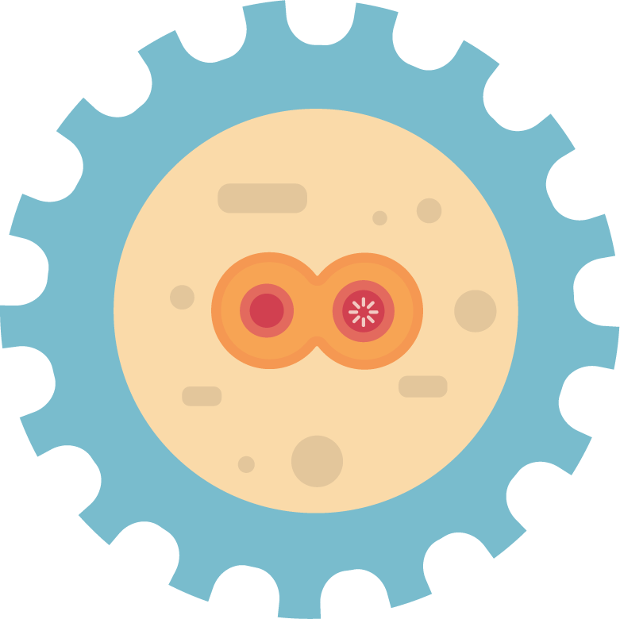
ONTARIO: GROWTH IN REGENERATIVE MEDICINE
Regenerative medicine has the potential to heal or replace tissues and organs damaged by disease or trauma by harnessing the power of stem cells, biomaterials and genetic modification. Promising a host of breakthrough treatments and potential cures for diseases, Ontario is at the forefront of this field.
One of the major benefits of locating your business in Ontario is that you’ll have access to support from institutions on the cutting-edge of regenerative medicine discovery. For example, Toronto’s Centre for Commercialization of Regenerative Medicine (CCRM) is a leader in helping companies develop and commercialize regenerative medicine technologies, as well as cell and gene therapies.
In 2016, CCRM partnered with GE Healthcare to establish the Centre for Advanced Therapeutic Cell Technologies. The centre works to tackle manufacturing challenges in cell and gene therapy production by creating a process that is automated and optimized for industrialization.
Through another partnership with the University Health Network, in 2018, CCRM launched the Centre for Cell and Vector Production. This collaboration enables them to meet the demand for manufactured clinical-grade cells and genes used in Phase I and II clinical trials.

Slide 18
ONTARIO: GROWTH IN REGENERATIVE MEDICINE
The Department of Medicine at Hamilton’s McMaster University is leading the way in infectious diseases research.
The Division of Infectious Diseases plays a critical role in the prevention and management of infectious diseases through research, clinical care and education. [ The Division connects ] fundamental research and epidemiological studies, benefiting patients across Canada as well as internationally.

Slide 19
ONTARIO: A GLOBAL LEADER IN CLINICAL TRIALS
Want your business to be in on the action? Ontario’s huge concentration of life sciences industries and its world-class research in cancer, stem cells and cardiovascular disease makes us a hotbed for life-saving clinical trials.
There are now more than 3,500 active clinical trials being conducted in this province. Of these, 1,400 are in cancer treatment—not surprising since Ontario is home to the Princess Margaret Cancer Centre, one of the world’s top-five cancer research institutes. In all, Ontario has 23 academic research hospitals, including six of Canada’s top 10.
The province’s dynamic ecosystem of scientific excellence, reputable research partners and low costs can help your company accelerate discovery and support revolutionary technologies in the field of medicine.

Slide 20
NON-PROFIT SUPPORT FOR CLINICAL TRIALS
Clinical Trials Ontario (CTO) is a leading non-profit in the clinical trials community dedicated to strengthening, promoting and capitalizing on Ontario’s competitive advantages for conducting high-quality clinical trials. Through its cost-effective process, CTO’s QuickSTART Program helps trial sites and industry sponsors establish standardized processes to improve efficiency and achieve a 90-day overall start-up time for clinical trials—months faster than the current standard.

Slide 21
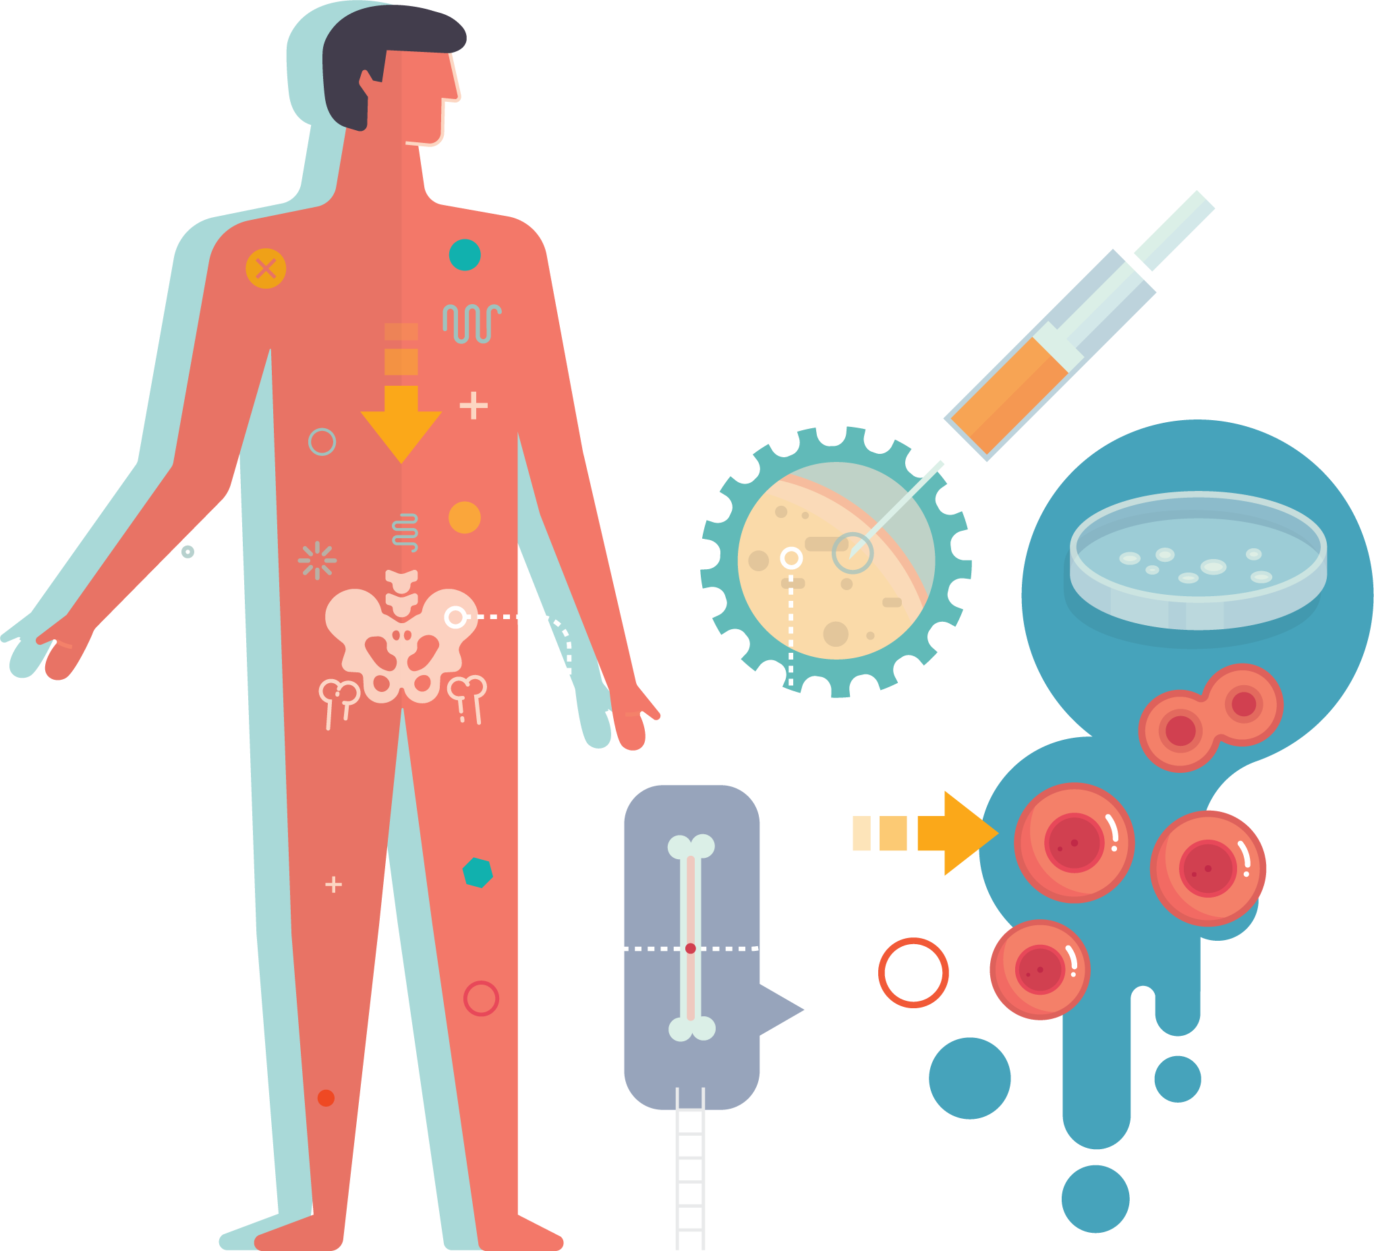
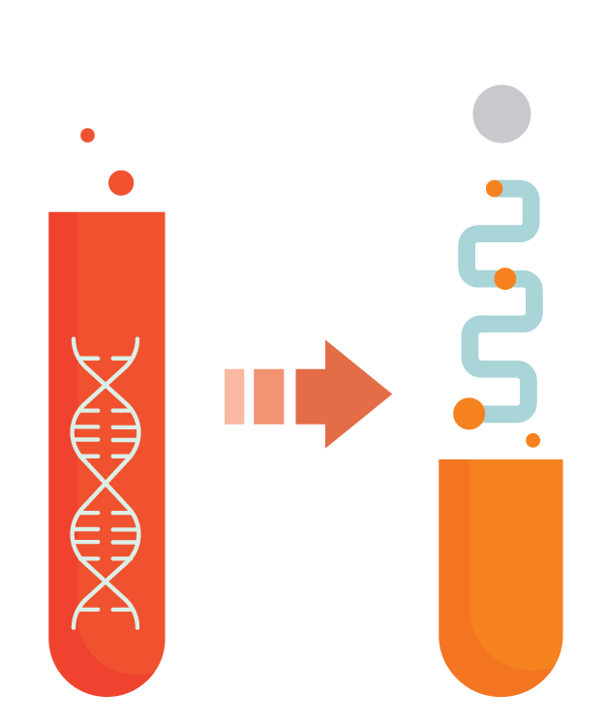
WHY INVEST IN ONTARIO?
ACCESS A PREMIER TALENT & INNOVATION ECOSYSTEM
EDUCATED 70% of Ontario adults possess a post-secondary education— a rate higher than any OECD country
ACADEMIC LEADERSHIP World-class academic and research institutions
INCUBATOR HUB Largest concentration of innovation incubators
IT CLUSTER 2nd-largest IT cluster in North America
R&D PROGRAMS Significant after-tax cost savings
IMMIGRATION SUPPORT Ontario Immigrant Nominee Program
BENEFIT FROM COMPETITIVE BUSINESS COSTS
TAXES Corporate tax rates are below the G7 average
LABOUR High-quality talent at up to 50% less than top U.S. tech hubs
EMPLOYER-PAID HEALTH CARE Almost 1/3 the cost of comparable U.S. regions, thanks to universal health care
EXCHANGE RATE Favourable exchange rate, typically 25% less than the U.S. dollar
RECEIVE CUSTOMIZED BUSINESS SUPPORT
CUSTOMIZED SERVICE Personalized support from Invest Ontario—our province’s new investment attraction agency
REGULATORY SUPPORT Regulatory environment that is easy to navigate. Canada is the 2nd-best location among the 38 OECD countries to start a business
TAILORED INSIGHTS Business intelligence and market opportunities
LOCATION SUPPORT Site selection and land planning services
PARTNERSHIPS Private and public sector partnerships
TAKE ADVANTAGE OF GLOBAL MARKET ACCESS
TRADE PARTNERSHIPS Trade agreements with 50 countries around the world
EASE OF TRANSPORT 4 international and 300 regional airports, 250,000 km of roads and highways, a dozen border crossings and the 6th most internationally connected airport in the world
MARKET PROXIMITY Access to hundreds of millions of people within a day’s drive
THRIVE IN A DIVERSIFIED & GROWING ECONOMY
DIVERSIFIED ECONOMY Strong representation in all sectors and industries
ECONOMIC POWERHOUSE Ontario is Canada’s economic engine
ECONOMIC STABILITY Stable political and economic climate
ECONOMIC SUCCESS Excellent GDP growth rate
EXPERIENCE AN EXCELLENT QUALITY OF LIFE
QUALITY OF LIFE Ranked among the best places to live and work in the world
DIVERSE POPULATION Ontario celebrates multiculturalism, representing 150 countries from every corner of the world
SAFETY & SECURITY Quality health care, transportation infrastructure and social support
TOURISM & ENTERTAINMENT World-class arts and culture attractions

Slide 22
HIGHLY SKILLED PEOPLE WORK HERE
Ontario’s number one advantage is its talented and diverse labour pool, which is changing the face of the life sciences industry one innovation at a time. From Frederick Banting to James Till, Ontario has a storied history of discovery amongst the medical community.
We have the leading talent your business needs to compete amongst the best in the world. The province is the top producer of STEM (science, technology, engineering and math) graduates in North America. Our 44 universities and colleges produce almost 55,000 STEM graduates each year—a number that is forecast to keep growing well into the future, making Ontario ripe for life sciences investment and exploration.
While our homegrown talent is plentiful, Ontario is also a key destination for highly skilled immigrants and prides itself on the strength that comes from its racial and cultural diversity. We know that the next big idea can come : from anyone and from anywhere, which is why we welcome talent from around the globe. In fact, your company can take advantage of Canada’s Global Skills Strategy, a fast-track program that expedites work visas for highly skilled workers from abroad in just 10 business days.

Slide 23
HIGHLY SKILLED PEOPLE WORK HERE
6
23
44
MEDICAL SCHOOLS
ACADEMIC RESEARCH HOSPITALS
UNIVERSITIES & COLLEGES
68,100
55,000
JOBS IN LIFE SCIENCES
STEM GRADUATES EACH YEAR

Slide 24
WHERE COLLABORATIVE ECOSYSTEMS SHINE
Convergence and innovation happen when you have a collaborative ecosystem of partners. Here in Ontario, hospitals, universities and research centres, technology and business incubators, start-ups and multinationals all come together, informing and cross-pollinating each other’s work. Here, your business can take advantage of these partnerships as you work towards a new era of discovery.
We know the economy of the future will be built on nanotechnology, blockchain and quantum science, artificial intelligence and deep learning. These technologies promise to revolutionize industries, making them faster, smarter and more competitive. These are fields in which Ontario is a global leader—and you can join the revolution.
Canada’s “Quantum Valley” along the Toronto-Waterloo corridor is home to the Perimeter Institute for Theoretical Physics, the Institute for Quantum Computing, Quantum Valley Ideas Lab and Quantum Valley Investments, who are all working to churn out the next generation of excellence in life sciences.

Slide 25
HOME TO
WORLD-CLASS INCUBATORS AND
ACCELERATORS
Ideas are the lifeblood of innovation—and it’s clear that ideas thrive in Ontario. A look at the diversity of life sciences companies that have spun off, sprung up or relocated here makes it clear that not only are ideas conceived here, they are also nurtured.
Your business can be a part of a network of 49 public and private incubators and accelerators that extend across Ontario, more than New York City, London, Tel Aviv or Berlin. All are geared to support your company as you transform today’s scientific discoveries into health care services for tomorrow.

Slide 26
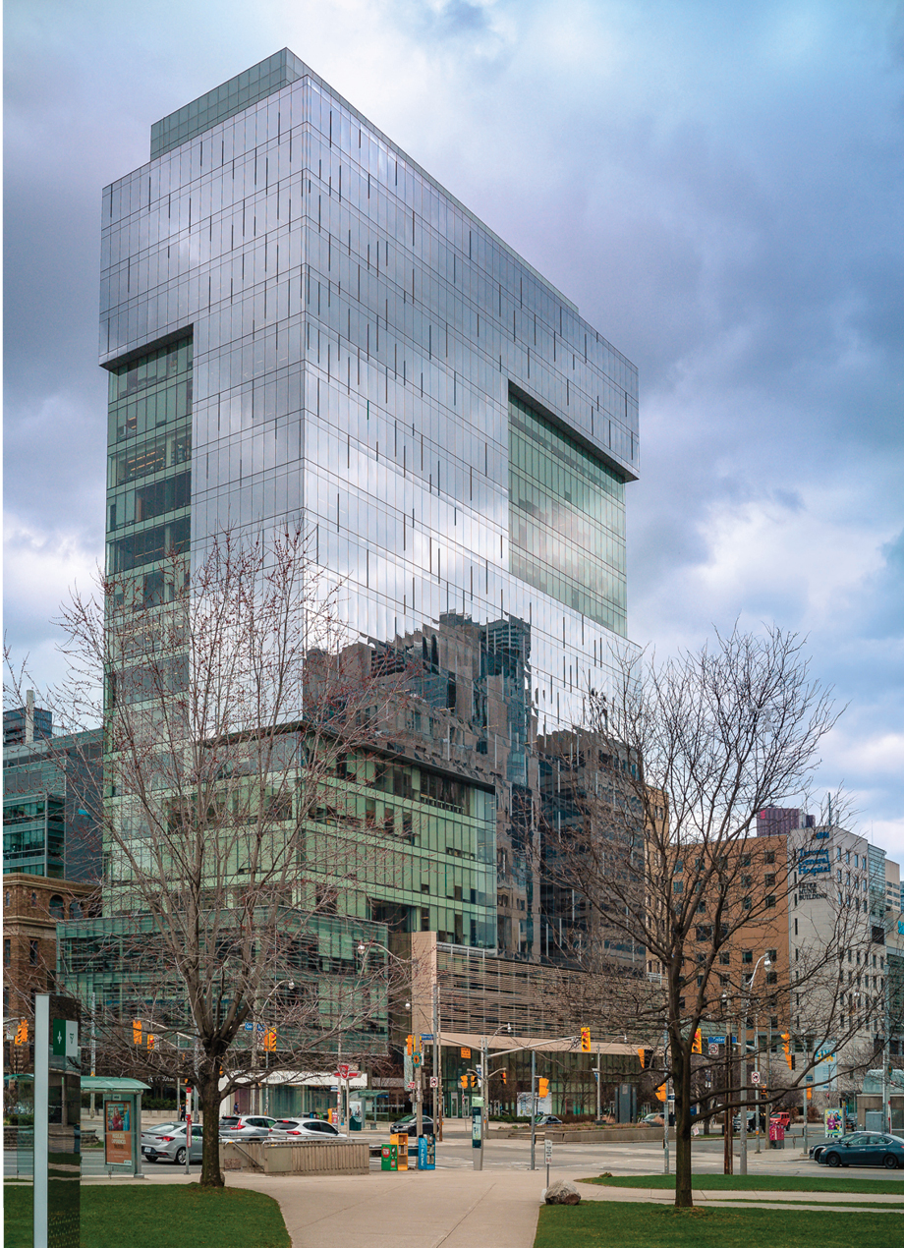
HOME TO
WORLD-CLASS INCUBATORS AND
ACCELERATORS
Some are in Toronto:
Ryerson DMZ is ranked the number one university-based business incubator by UBI Global
MaRS Discovery District, the world’s largest innovation hub
Creative Destruction Lab, a seed-stage program for science-based companies, including the world’s first quantum machine learning accelerator
MaRS Discovery District Toronto

Slide 27
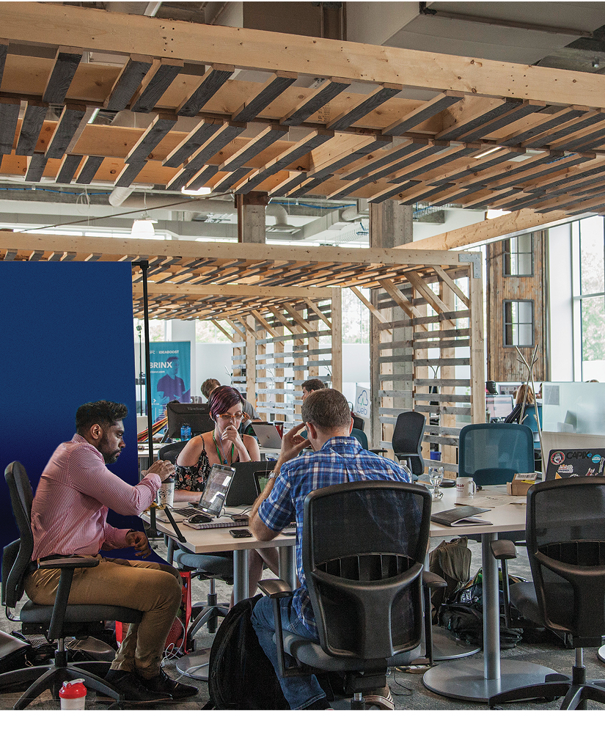
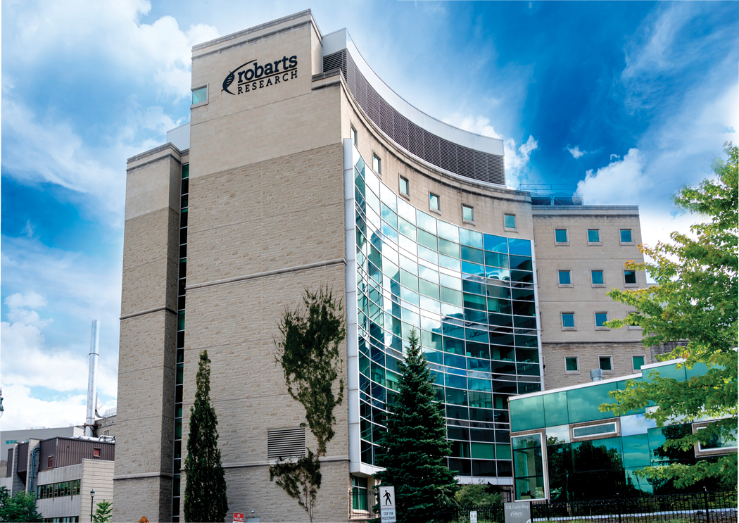
HOME TO
WORLD-CLASS INCUBATORS AND
ACCELERATORS
Bayview Yards Ottawa
Many are spread across the province:
Velocity Garage in Waterloo, the world’s largest free start-up incubator
Bayview Yards in Ottawa, a one-stop business acceleration shop
Innovation Shop in Hamilton that supports small- and medium-sized enterprises with innovation and commercialization
Western Research Parks in London, Ontario, a 50-acre science and technology park affiliated with the country’s leading universities
Western Research Parks London

Slide 28
THE FUTURE OF
LIFE SCIENCES IN ONTARIO
There is no doubt that the COVID-19 pandemic has thrust the life sciences industry onto centre stage. Companies across the globe are developing forward-thinking products and solutions to ensure we are future-ready. And Ontario is no exception. In fact, our life sciences sector is full of the bold ideas and extraordinary brainpower needed to take the industry by storm.
What makes the province’s life sciences sector unique is its connection to the fourth industrial revolution (or Industry 4.0). Advances, especially in artificial intelligence, continue to promote cross-sector links as they transform how we develop new approaches to integrating health care in unimaginable ways. The pace of innovation is quicker than ever, and Ontario is leading the charge.
We know that top life sciences firms like yours are looking for a steady supply of top talent, competitive costs, a stable business environment and access to investors—and we know that you can find it in Ontario. Imagination is in our DNA, and from the lab to the line, we’ll be with you every step of the way.

Slide 29
THE FUTURE OF
LIFE SCIENCES IN ONTARIO
SANOFI INVESTS $1B IN VACCINE DEVELOPMENT
With support from the provincial, federal and municipal governments, pharmaceutical giant Sanofi invested $1 billion in their historic Connaught site in Toronto, Ontario. This investment enables the company to bulk manufacture Fluzone High-Dose Quadrivalent Influenza Vaccine—a flu vaccine approved for people 65 years and older. The facility will include industrial- scale formulation, filling and packaging—a key requirement for pandemic preparedness.

Slide 30
BlueDot: BRINGING ONTARIO TO THE FOREFRONT OF COVID-19 DETECTION
Toronto-based BlueDot was among the first to warn the world of COVID-19—on New Year’s Eve 2019—using their AI-driven infectious disease surveillance solution. The company uses AI to scour more than 100,000 articles every day in 65 languages looking for news about more than 150 different diseases. On December 31, 2019, BlueDot issued an alert to its clients about a “pneumonia of unknown cause” spotted in articles emerging from China. That warning came nearly a week before the U.S. Centers for Disease Control and Prevention and the World Health Organization issued their public alerts about the novel coronavirus.
Today, BlueDot’s COVID Data Suite delivers bespoke, near-real-time intelligence to governments, hospitals and airlines, revealing COVID-19’s movements.

Slide 31
BlueDot in Toronto was among the first in the world to identify the spread of COVID-19, coming in nine days ahead of the World Health Organization’s public warning. We’ve signed a contract to use this Canadian software to model the disease.
JUSTIN TRUDEAU
Prime Minister of Canada

Slide 32
LEARN MORE
InvestOntario.ca
ONE CALL. ALL THE ANSWERS.
+1 416-313-3469
FOLLOW US
company/investontario @investontario

