Slide 1
Information Technology Thrives in Ontario, Canada

Slide 2
70%
Information Technology in Ontario, Canada
OF OUR WORKING-AGE ADULTS AGED 25 TO 64 YEARS HAVE COMPLETED POST-SECONDARY EDUCATION, A RATE HIGHER THAN ANY OTHER OECD COUNTRY
WHERE STARTUPS AND GLOBAL GIANTS GROW SIDE BY SIDE
The world’s most innovative technologies and companies thrive in Ontario: from artificial intelligence to quantum computing, from Amazon to Shopify. Ontario is where cutting-edge thinking is powered by a dynamic ecosystem of R&D and talent and where startups and global giants grow side-by-side. By locating your business in Ontario, you will have access to North America’s second-largest information technology (IT) hub, with over 35,000 high-tech firms generating a GDP of over$65 billion.
You will also be a part of our expansive IT corridor—which runs from Windsor and Waterloo in the West to Toronto in the centre to Ottawa in the East. This innovation highway covers two of the three most concentrated tech markets in North America and two of the largest startup ecosystems in the world.
We want to make it easy to build and grow your business in Ontario. We pride ourselves on having the premier technology companies need to succeed, including the world’s most advanced cloud computing and big data analysis expertise, coupled with an expanding 5G network. We are strategically located within a day’s drive to 187 million consumers across North America and are well-connected to the rest of the world through our four international airports, making it easy for you to do business globally.
You’ll find value and cost-savings here too. Ontario’s corporate income tax rate is lower than the average rate in G7 countries, and our R&D tax credits are among the most generous in the OECD. Over the past 10 years, Ontario has ranked fifth in the G7 for IT-related foreign direct investment (FDI) capital expenditures—a ranking that includes more than one hundred subnational regions across North America, Europe and Asia.
We are where IT companies succeed, and we’re ready for you.
TORONTO
is North America’s fastest growing tech market
All figures are in Canadian dollars (CAD) unless otherwise stated. The information in this book is accurate at the time of publication.
© Queen’s Printer for Ontario, 2022

Slide 3
ONTARIO’S IT INDUSTRY
BY THE NUMBERS
OVER
NEARLY
35,000
320,000
55,000
HIGH-TECH BUSINESSES
IT Workers
ANNUAL STEM GRADS
$65B
$7.4B
GDP ANNUALLY IN THE IT SECTOR
IN IT-RELATED EXPORTS in 2019

Slide 4
WHY ONTARIO FOR INFORMATION TECHNOLOGY
ONTARIO’S TRADE AND INVESTMENT OFFICES ARE LOCATED AROUND THE WORLD
1,200 km ( 750 miles )
800 km ( 500 miles )
400 km ( 250 miles )
LONDON
CHICAGO
NEW YORK
PARIS
MUNICH
BEIJING
SAN FRANCISCO
WASHINGTON, D.C.
SEOUL
TOKYO
DALLAS
SHANGHAI
NEW DELHI
CHONGQING
MUMBAI
MEXICO CITY
16
ACCESS TO CONSUMERS
187 million consumers within a day’s drive of the Greater Toronto Area
TRADE AND INVESTMENT OFFICES AROUND THE WORLD with headquarters in Toronto

Slide 5
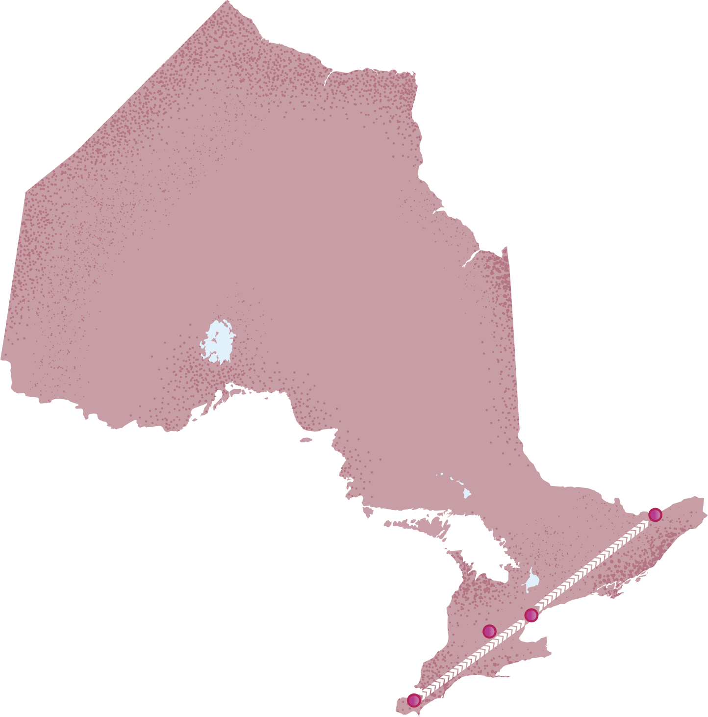
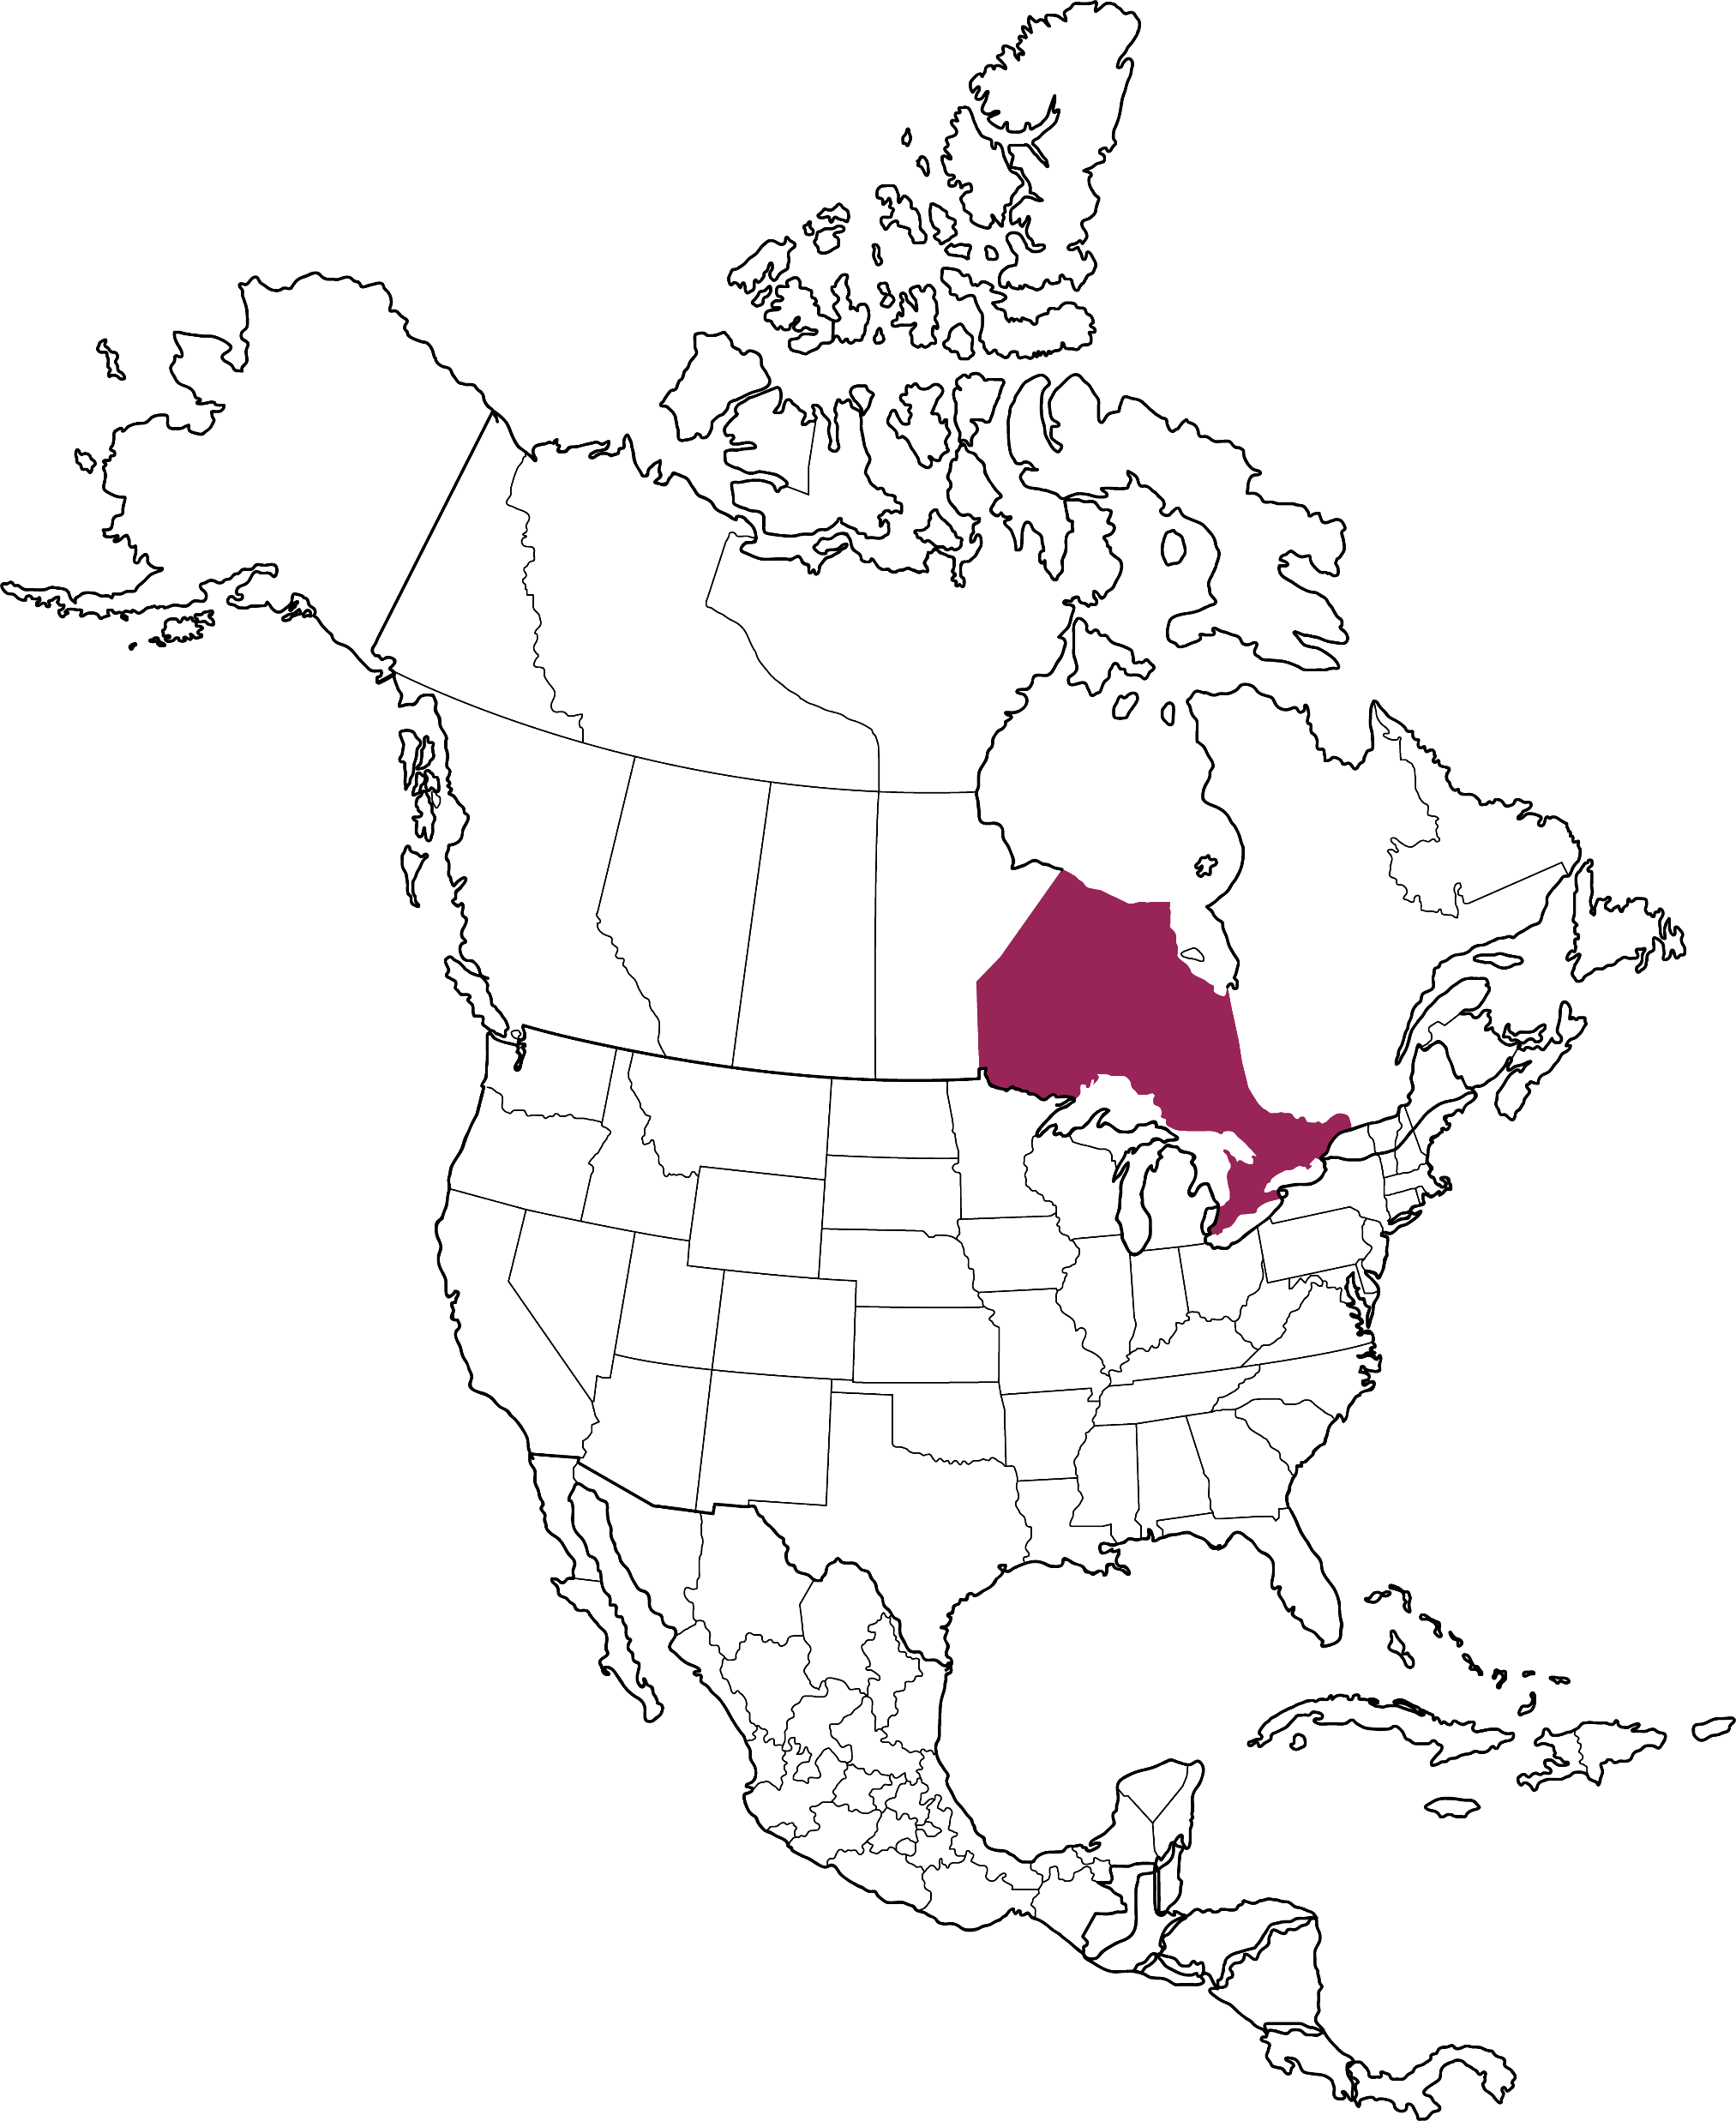
WHY ONTARIO FOR INFORMATION TECHNOLOGY
INNOVATION HIGHWAY
Be a part of our expansive IT corridor which runs from Windsor and Waterloo in the West to Toronto in the centre and Ottawa in the East.
OTTAWA
TORONTO
WATERLOO
DOZENS
2ND
WINDSOR
OF WORLD-RENOWNED RESEARCH INSTITUTE
LARGEST IT CLUSTER IN NORTH AMERICA

Slide 6
Our new engineering office in Toronto will help Pinterest access world-class engineering and machine learning talent while contributing to the technology community in [ Ontario ].
RAHIM DAYA PINTEREST INTERNATIONAL PRODUCT LEAD

Slide 7
WHY ONTARIO FOR INFORMATION TECHNOLOGY
AMD
APPLE
BLACKBERRY
CISCO
ERICSSON
FUJITSU
GOOGLE
IBM
INTEL
LG
MICROSOFT
NOKIA
NVIDIA
OPENTEXT
ORACLE
QUALCOMM
SAMSUNG
SAP
SHOPIFY
XEROX
IT
GIANTS LIVE
HERE

Slide 8
ONTARIO: ARTIFICIAL INTELLIGENCE LIVES HERE
Artificial intelligence (AI) was pioneered in Ontario more than 30 years ago when world-renowned University of Toronto scientist Geoffrey Hinton first discovered neural nets.
Today, Ontario is at the epicentre of an AI-enabled future, with more than 400 artificial intelligence firms and institutions paving the way for a better tomorrow. The industry is growing rapidly, thanks to significant investments from the provincial and federal government and private companies who see the unique value in our AI-ecosystem. In September 2018 alone, Ontario’s AI sector attracted more than $1 billion in investments by tech giants that included Intel, Microsoft and Samsung, so by choosing the province, you’re among good company.
Like our IT industry, our AI sector encompasses diverse technologies and applications to set your business up for success. We’re using AI to automate drug development, stop online fraud, improve customer interactions and make the law more transparent and accessible. We’re putting it to work in our auto industry, financial services, life sciences and clean technology. The possibilities are truly limitless for AI in Ontario—and for you.
400+
AI firms

Slide 9
VECTOR INSTITUTE: CHOOSING ONTARIO AS A CENTRE FOR EXCELLENCE IN AI
WE SELL TO AMERICAN COMPANIES, AND WE’RE BASED IN TORONTO. WE KEEP HEARING, OH, OF COURSE YOU’RE FROM TORONTO, THAT’S WHERE DEEP LEARNING IS FROM.
Canada’s reputation as a centre of excellence in AI research and development got a boost in 2017 with the opening of the Vector Institute in Toronto. Established through a partnership between government and industry, the institute supports AI startups while developing their next-generation transformational technology. The goal then, as it is now, was to keep innovative ventures from leaving the country and entice multinational companies to set up their AI R&D centres in Ontario.
With AI pioneer Geoffrey Hinton as its chief scientific advisor, Vector works with institutions, industry startups, incubators and accelerators to advance AI research and drive its application and commercialization across Canada.
JORDAN JACOBS
CO-FOUNDER
VECTOR INSTITUTE

Slide 10
AI is going to have as much impact on the world as the industrial revolution, and we’re able to advance AI right here in Ontario.
GAVRIEL STATE
SENIOR DIRECTOR
SYSTEM SOFTWARE AT NVIDIA

Slide 11
ONTARIO:
LOCKING DOWN SOLUTIONS FOR CYBERSECURITY
Upgrade your company’s talent pool in Ontario. Here, you’ll find the world’s leading minds in cryptology, quantum computing and other security-enhancing technologies, who are leading ground-breaking research and bringing innovative solutions to market.
Our cybersecurity industry is a powerful triangle of clusters in Toronto, Waterloo and Ottawa, with emerging hubs in the Southwestern, Northern and Eastern regions of the province. Ontario cybersecurity businesses range from global giants like BlackBerry to newcomers like Tehama, so no matter the size of your business, there is a home for you in the province.
If you’re interested in collaboration, Ontario is where industry, academics and governments work together to solve the world’s most pressing security problems. We’ve got scientists exploring futuristic solutions at the University of Waterloo’s Institute for Quantum Computing and the Cybersecurity and Privacy Institute. At Ryerson University’s Rogers Cybersecure Catalyst, industry thought leaders are developing policies and alternative education programs that tackle the serious challenges of cybersecurity.
For businesses that want to seize opportunities in cybersecurity, think Ontario.

Slide 12
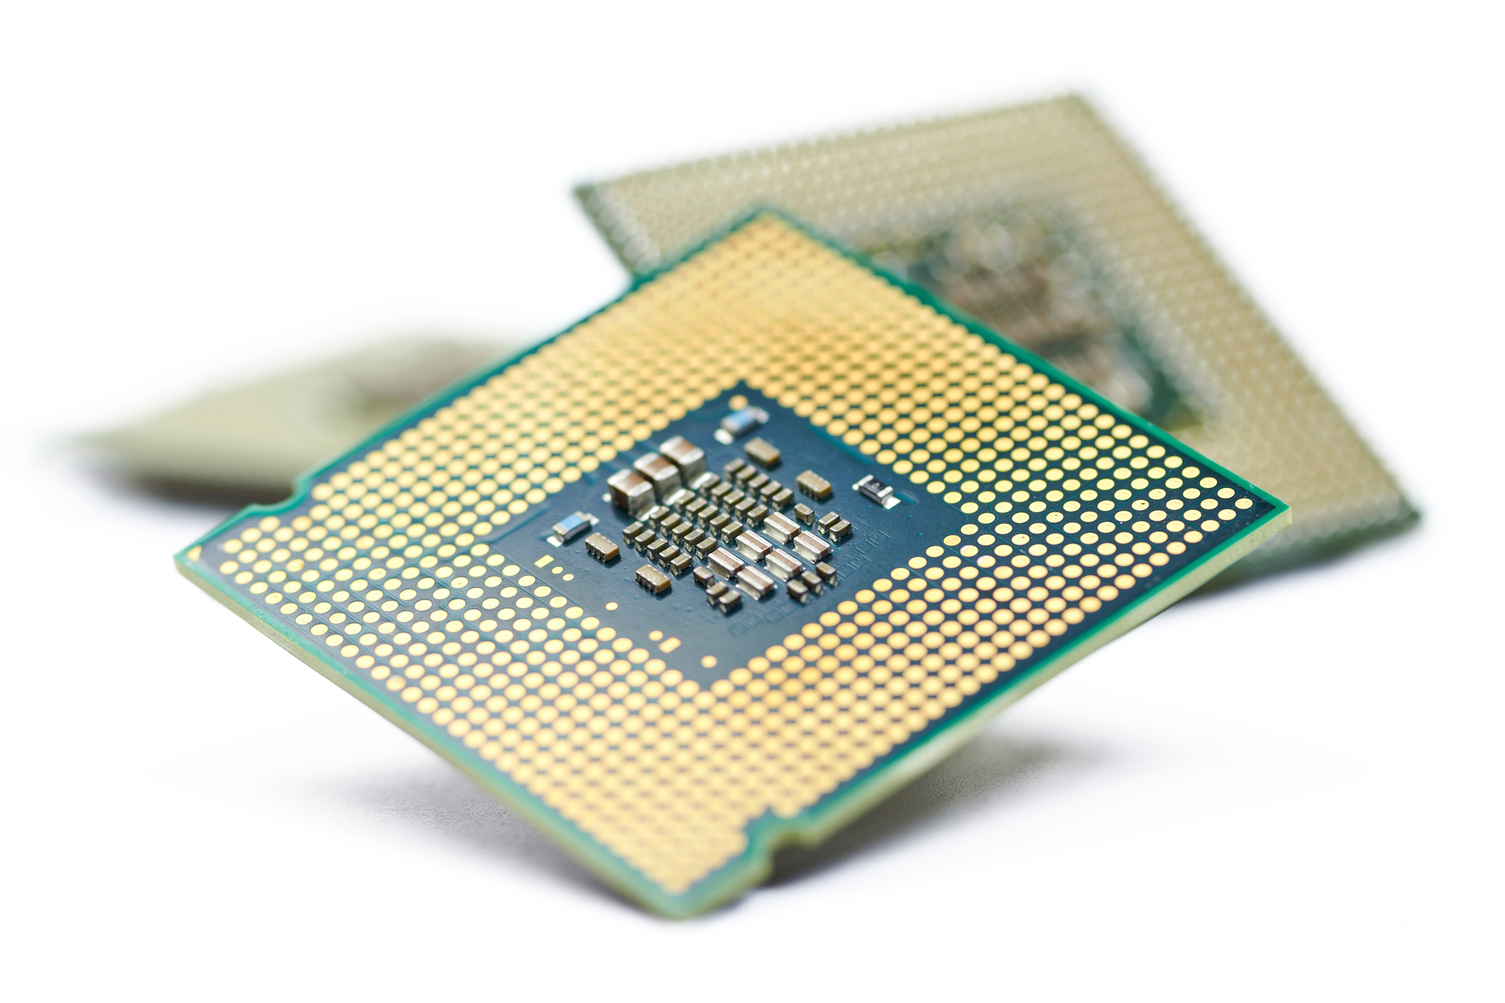
ONTARIO: MICROELECTRONICS HAVE A BIG IMPACT
Thinking small—very, very small—can pay off big. That’s the story of Ontario’s microelectronics sector, where innovators and makers of electronic circuits, microchips and semiconductors continue to drive huge advances in virtually every technology product and application.
Tech giants deliver unbelievable magnitudes of performance from minuscule platforms. To build microelectronics, design engineering firms, components suppliers and manufacturers draw upon Ontario’s deep expertise in nanotechnology, artificial intelligence, robotics and advanced manufacturing.
There’s significant government support for companies in this industry. Your business can benefit from a competitive manufacturing tax rate of 25% and have access to research and services from such institutions as the Mike and Ophelia Lazaridis Quantum-Nano Centre at the University of Waterloo, the Centre for Emerging Device Technologies at McMaster University and the Hardware Catalyst Initiative at ventureLAB, part of Ontario’s innovation corridor.
If you’re a small thinker ready to make a big impact, think Ontario.

Slide 13
NVIDIA: FROM SILICON VALLEY TO ONTARIO
Made-in-Ontario gaming technology caught the eye of NVIDIA Corporation—the California-based inventor of the graphics processing unit (GPU) logic chips that power everything from Nintendo games and Hollywood films to advanced computing and autonomous cars. As a result, the global giant acquired the technology and business unit behind it and launched NVIDIA Development in Toronto with a focus on gaming-related hardware, software and AI.
“We have access to an amazing pool of talent in Toronto and Ontario as a whole,” says Gavriel State, senior director, simulation and AI at NVIDIA. “We’ve been very successful in recruiting skilled people with degrees in computer science and engineering.”

Slide 14
ONTARIO: WHERE FINTECH LEADERS LIVE
From mobile payments to cybersecurity, trading analytics to blockchain, Ontario is a leader in fintech. Toronto, Ontario is North America’s second-largest financial hub and a global epicentre for fintech activity. It’s where key technology decisions are made in the financial services industry.
Toronto is ranked as the most attractive centre for fintech companies and the fastest growing financial sector in North America. With the right combination of leading financial institutions, one of the largest stock exchanges in the world (TSX), financial stability and a technology-forward ecosystem, it’s no wonder Ontario is the place where fintech innovators are finding success on the world stage.
700+
FINTECH firms

Slide 15
ONTARIO: WHERE FINTECH LEADERS LIVE
WHO’S HERE IN FINTECH
BORROWELL
CLEARCO
DREAM PAYMENTS
FRESHBOOKS
GIESECKE+DEVRIENT
INGENICO
INTERAC
KOHO
MASTERCARD
OBERTHUR TECHNOLOGIES
PAYPAL
SECUREKEY
SENSIBILL
SHOPIFY
SQUARE
THALES
VISA
WEALTHSIMPLE

Slide 16
Achieving a unicorn valuation from some
of the world's most respected investors is not only
an exciting moment for us, but an exciting thing for the Canadian technology scene.
As a business, we think it’s a huge validation of what we’ve built, and more importantly, where we’re going.
MIKE KATCHEN, CEO
WEALTHSIMPLE
Source: BetaKit, October 14, 2020

Slide 17
ONTARIO: INTERACTIVE DIGITAL MEDIA THAT’S PLAYED AROUND THE WORLD
IT ADDS UP
ONTARIO’S DIGITAL MEDIA TAX CREDIT
In Ontario, digital media companies get a tax credit THAT PROVIDES A TAX REFUND OF UP TO 40% on the costs of labour as well as some of the marketing and distribution for games created in the province.

Slide 18
ONTARIO: 5G HAS LANDED, AND TAKEN OFF
Ontario is at the forefront of the 5G revolution—and we want you to join us as we develop the next generation of cellular network standards that will usher in better internet on smartphones and unlock leading-edge applications.
We have already started rolling out 5G through partnerships forged by Canada’s three largest telecommunications companies—Rogers, Bell and Telus—with global industry leaders Ericsson and Nokia, so you will be a part of an already established ecosystem of excellence.
Ontario has joined forces with the Quebec and Canadian governments to accelerate the expansion of 5G networks and technologies in the country. As part of this alliance, we launched an open platform where small- and medium-sized enterprises can develop and test ideas for 5G.
These partnerships translate into great opportunities for your business in the global 5G market—a market that is forecasted to grow into a US$251-billion industry by 2025.
WHO’S HERE IN 5G
AVAYA
CIENA
CISCO
ERICSSON
HUAWEI
JUNIPER NETWORKS
LUMENTUM
MITEL
NOKIA
RIBBON COMMUNICATIONS

Slide 19
ONTARIO: INTERACTIVE DIGITAL THAT’S PLAYED AROUND THE WORLD
In search of a home for your creative team? Consider Ontario, where you’ll find the best place for interactive digital media expertise. If you’ve watched a special-effects movie, played a video game or used a mobile app, then chances are you’ve experienced content and technology made right here in Ontario. Our digital media companies create content, products and services that are viewed and used around the world.
By choosing Ontario, your interactive digital media company can take advantage of the lowest business costs for video game production among the major cities of G7 countries. You can also tap into our skilled, highly educated and multilingual workforce and the talent coming out of our digital gaming education programs.
Our companies represent the entire spectrum of digital media business activities—from animation and 3D rendering to post-production and marketing. Whether you’re a video game maker like Ubisoft or a special effects software provider like Autodesk, you’ll find what you need to advance to the next level in Ontario.

Slide 20
WHY INVEST IN ONTARIO?
ACCESS A PREMIER TALENT & INNOVATION ECOSYSTEM
EDUCATED 70% of Ontario adults possess a post-secondary education— a rate higher than any OECD country
ACADEMIC LEADERSHIP World-class academic and research institutions
INCUBATOR HUB Largest concentration of innovation incubators
IT CLUSTER 2nd-largest IT cluster in North America
R&D PROGRAMS Significant after-tax cost savings
IMMIGRATION SUPPORT Ontario Immigrant Nominee Program
BENEFIT FROM COMPETITIVE BUSINESS COSTS
TAXES Corporate tax rates are below the G7 average
LABOUR High-quality talent at up to 50% less than top U.S. tech hubs
EMPLOYER-PAID HEALTH CARE Almost 1/3 the cost of comparable U.S. regions, thanks to universal health care
EXCHANGE RATE Favourable exchange rate, typically 25% less than the U.S. dollar
RECEIVE CUSTOMIZED BUSINESS SUPPORT
CUSTOMIZED SERVICE Personalized support from Invest Ontario—our province’s new investment attraction agency
REGULATORY SUPPORT Regulatory environment that is easy to navigate. Canada is the 2nd-best location among the 38 OECD countries to start a business
TAILORED INSIGHTS Business intelligence and market opportunities
LOCATION SUPPORT Site selection and land planning services
PARTNERSHIPS Private and public sector partnerships
TAKE ADVANTAGE OF GLOBAL MARKET ACCESS
TRADE PARTNERSHIPS Trade agreements with 50 countries around the world
EASE OF TRANSPORT 4 international and 300 regional airports, 250,000 km of roads and highways, a dozen border crossings and the 6th most internationally connected airport in the world
MARKET PROXIMITY Access to hundreds of millions of people within a day’s drive
THRIVE IN A DIVERSIFIED & GROWING ECONOMY
DIVERSIFIED ECONOMY Strong representation in all sectors and industries
ECONOMIC POWERHOUSE Ontario is Canada’s economic engine
ECONOMIC STABILITY Stable political and economic climate
ECONOMIC SUCCESS Excellent GDP growth rate
EXPERIENCE AN EXCELLENT QUALITY OF LIFE
QUALITY OF LIFE Ranked among the best places to live and work in the world
DIVERSE POPULATION Ontario celebrates multiculturalism, representing 150 countries from every corner of the world
SAFETY & SECURITY Quality health care, transportation infrastructure and social support
TOURISM & ENTERTAINMENT World-class arts and culture attractions

Slide 21
Information Technology in Ontario, Canada
A RESEARCH AND DEVELOPMENT
POWERHOUSE
Ontario’s rich R&D ecosystem is one reason the world’s most innovative companies choose to build and grow here.
We’re an R&D powerhouse fuelled by $9.21 billion in business expenditures in research & development in 2018. Want your company to be surrounded by some of the best in the business? We’re the site of global R&D centres for homegrown IT leaders like OpenText, BlackBerry and Shopify and foreign-based titans like LG, Cisco and Ericsson.
It makes good sense for your business to explore and test new ideas in Ontario. With nearly 55,000 students graduating from STEM programs in 2018, Ontario boasts some of the best minds for discovery. We also make it easier for small- to medium-sized manufacturers to invest in R&D by providing tax credits that reduce every $100 in after-tax R&D spending to $47.49 if the work is done in-house, $60.28 if outsourced and $50.44 if the R&D work is carried out at an eligible Ontario research institute.
$9.21B
In R&D business expenditures

Slide 22
OTTAWA’S TECH LEADERSHIP
Ottawa has the highest concentration of technology talent in its labour force in North America, edging out Silicon Valley industry by 2025.
Area X.O test facility in Ottawa, Ontario

Slide 23
IBM: LIFE-SAVING AI INVENTED HERE
IBM Watson—the world-famous, Jeopardy-winning AI from IBM—is helping Ontario companies perform ground-breaking research and development. Leveraging IBM Watson’s significant brainpower, researchers have embarked on drug discovery to fight Parkinson’s disease and research to identify and personalize treatment options for cancer patients.
Collaborations with IBM give Ontario researchers and businesses access to an array of Watson cognitive and analytics software, expertise in cloud computing and high-performance computing infrastructure. Partnerships with IBM also connect companies to a network of global collaborators in the IT space and beyond.

Slide 24
ONTARIO: THE BEST AND BRIGHTEST WORK HERE
People are paramount in knowledge-based organizations, and we have the expertise that your business needs to succeed. It’s no secret that Ontario’s IT talent pool is one of the key reasons why so many tech companies choose to build and grow here.
More than eight out of every 10 IT workers in Ontario has a post-secondary degree, and many are educated at top-ranked schools such as the University of Toronto and University of Waterloo, whose graduates are the second most frequently hired by Silicon Valley. Yet our tech workers cost up to 50% less to hire than those in San Francisco, and we have similar high-quality talent in top U.S. IT hubs such as Boston or New York.
With more than 323,000 workers, our IT talent pool is the largest in the country, accounting for almost half of all Canadians working in the industry. As more STEM students graduate and more tech jobs are created in Ontario, our IT workforce will continue to grow, meaning you’ll always have access to a steady pipeline of high-quality innovators.
Ontario’s IT workforce is advancing, becoming more specialized as education programs evolve to keep in step with growing fields such as artificial intelligence—and that’s adding even more brilliance to a talent pool that’s already among the world’s best and brightest.
.

Slide 25
WE’RE IMMIGRATION FRIENDLY
DID YOU KNOW?
Canada’s Global Skills Strategy is a fast-track program that EXPEDITES WORK visas for highly skilled workers from around the world IN 10 BUSINESS DAYS.

Slide 26
TOP RESEARCHERS ARE WITHIN EASY REACH
UNPARALLELED TALENT
Fierce competition drives our ongoing innovation and success in the IT industry. But this is also a place where industry, academia and governments collaborate to discover the next big thing.
As an Ontario-based business, you’ll have access to industry-leading scientists and laboratories in research institutes across the province. Our IT research centres have expertise in a comprehensive range of fields: from communication and cryptography to geoinformatics and wireless technologies.
Whatever you’re working on, we can promise you’ll be innovating with researchers who are recognized as the top brains in their field, both in Canada and around the world. Faculty members at Ontario universities hold more than 40% of Canada Research Chairs funded by the Canadian Institutes for Health Research and the Natural Sciences and Engineering Research Council. Ontario universities also receive nearly 40% of total sponsored research income at Canada’s Top 50 research universities.
48%
of Canada’s IT workers are in Ontario
2ND
LARGEST IT CLUSTER IN NORTH AMERICA

Slide 27
ARE YOU
READY
FOR YOUR
FUTURE?
WE ARE.
We are always advancing. Always innovating. And we’re ready to help build your future. Ontario’s IT industry is in a constant state of evolution as it leads the market with new products and services while keeping up with emerging trends and technologies.
In Ontario, we are setting the pace for a new era in information technology—working on AI applications that will be pervasive game-changers, for example, affecting virtually every facet of home life, work and industry. AI will steer the cars we travel in, automate more of our work tasks and determine the most efficient processes in manufacturing.
Our work in cybersafety and security will be more important than ever, as will their quantum-based solutions. Add in 5G and all the potential applications for next-generation broadband, and your business will be part of an ecosystem poised to change the world in a dramatic way.
Ontario is ready, and we’re looking forward to welcoming you to the next generation of innovation.

Slide 28
LEARN MORE
InvestOntario.ca
ONE CALL. ALL THE ANSWERS.
+1 416-313-3469
FOLLOW US
company/investontario @investontario

