Slide 1
Advanced Manufacturing in Ontario, Canada: Build Your Future Here

Slide 2
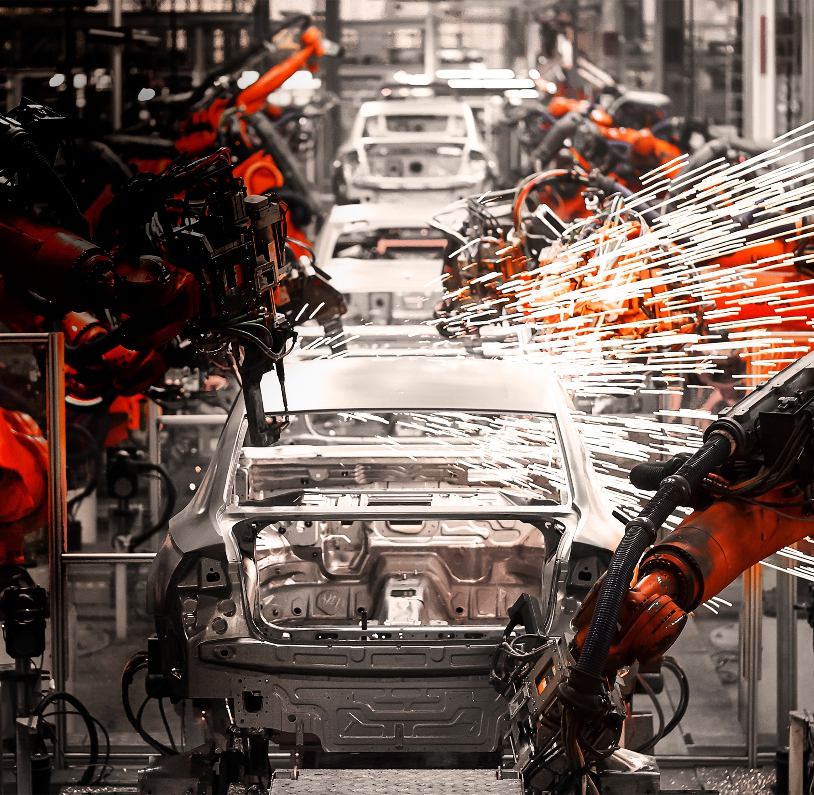

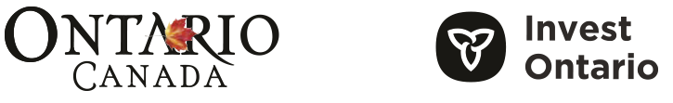
Advanced Manufacturing in Ontario, Canada
ONTARIO, CANADA:
A HISTORY OF QUALITY,
A FUTURE OF INNOVATION
There’s never been a more challenging—or exciting—time
to be a global manufacturer, and in Ontario, Canada, we have the tools your company needs to build
the future.
We know that businesses driven
to produce the next generation of innovation are turning to advanced technologies, including artificial intelligence, advanced robotics, the Internet of things (IoT) and deep learning/analytics to ensure their products are built both cost-competitively and sustainably.
These are technologies that
demand unique, high-level skills, an innovative ecosystem and a strong digital infrastructure.
You’ll find all that in Ontario, Canada.
It’s why leading manufacturers in every industry choose to locate and operate here. And, it’s why
we continue to build out our capabilities on all fronts.
We pride ourselves on our collaborative approach to manufacturing, where a fellowship of the best and brightest in their fields re-tool and reimagine the sector—and we want your business to be a part of that community.
One of our latest partnerships ensures companies both big and small can succeed in the province. The Ontario Advanced Manufacturing Consortium, a collaboration between McMaster University, the University of Waterloo and Western University, provides the sector with easy access to world-class facilities and expertise to help drive the next generation of manufacturing excellence.
Join us and discover
how Ontario can help
your business prosper.
All figures are in Canadian dollars (CAD) unless otherwise stated.
The information in this book is accurate at the time of publication.
© Queen’s Printer for Ontario, 2022

Slide 3

Countries that currently possess
or are investing actively in the skills,
capital and infrastructure of the future are
the ones that will dominate global manufacturing in the years ahead.
BROOKINGS INSTITUTION

Slide 4










WHY ONTARIO
FOR ADVANCED MANUFACTURING
Sault Ste. Marie
Ottawa
Maitland
Manufacturing Clusters
in Ontario
Kingston
Automotive
Chemical and biochemical
Aerospace
Clean Technology
Alliston
Oshawa
Brampton
Waterloo
Toronto
Kitchener
Cambridge
Oakville
Woodstock
Hamilton
St. Catharines
Ingersoll
Niagara Region
London
Sarnia
Windsor

Slide 5

WHY ONTARIO
FOR ADVANCED MANUFACTURING
Manufacturing [ in Ontario ] is being
reshaped in revolutionary ways. That shift opens the door to new opportunities in advanced manufacturing.
PATRICK DEANE
PRESIDENT
McMaster University

Slide 6
WHY ONTARIO
FOR ADVANCED MANUFACTURING
I’m so impressed with the pool of talent we have here in [ Ontario,] Canada and
the range of potentially world-changing innovations emerging from our ecosystems.
TYLER HAMILTON
DIRECTOR OF ECOSYSTEM, CLEANTECH
MaRS Discovery District

Slide 7

WHY ONTARIO
FOR ADVANCED MANUFACTURING
16 TRADE AND INVESTMENT OFFICES
AROUND THE WORLD
WITH HEADQUARTERS IN TORONTO
1,200 km ( 750 miles )
800 km ( 500 miles )
400 km ( 250 miles )
LONDON
CHICAGO
NEW YORK
PARIS
MUNICH
BEIJING
SAN FRANCISCO
WASHINGTON, D.C.
SEOUL
TOKYO
DALLAS
SHANGHAI
NEW DELHI
CHONGQING
MEXICO CITY
MUMBAI
Access to Consumers
187 million consumers within a day’s drive of the Greater Toronto Area

Slide 8
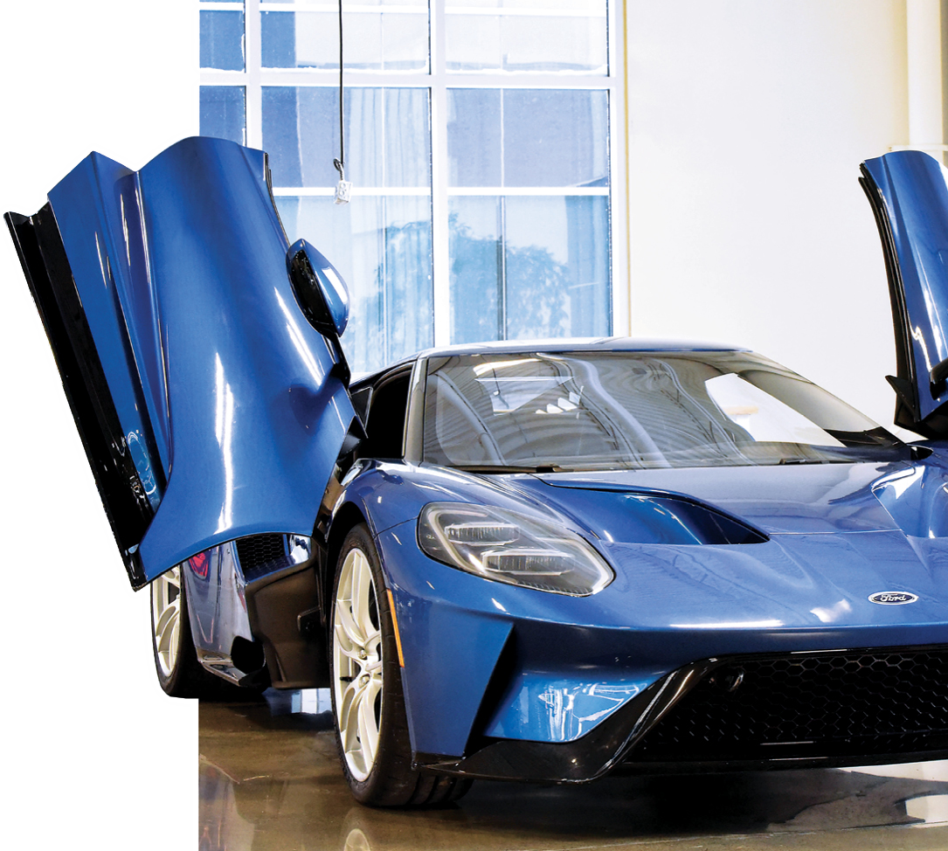


ONTARIO:
WHERE
AUTO DRIVES
THE FUTURE
The Ford GT supercar is being built exclusively in Markham, Ontario, at the Multimatic assembly plant.
Along the 800-kilometre innovation corridor that stretches from Windsor to Ottawa lies one of the richest concentrations of auto-related resources anywhere in the world. This corridor offers your business access to a unique fusion of technological innovation and manufacturing production expertise in a collaborative environment.
Twelve leading universities and 24 colleges with auto-focused programs provide a steady pipeline of talent for your company to tap into.
And state-of-the-art research centres, like the Automotive Centre of Excellence in Oshawa and the Waterloo Centre for Intelligent Antenna and Radio Systems, are racing to build technologies for all four of the ACES: Autonomous, Connected, Electric and Sharing. Plus, Ontario’s Autonomous Vehicle Innovation Network (AVIN) is looking at ways to improve every aspect of autonomous and connected driving, from 3D mapping to V2X communications, from incubating talent to building automobiles—so your business will be where the cutting-edge of automotive research lives.
If you’re interested in the province’s automotive ecosystem,
you’re in good company.
Big names like GM, Stellantis and Ford are investing millions of dollars to expand their Ontario operations and build the cars of the future. It’s no wonder virtually every automobile built today has Ontario-made technology inside, courtesy of Blackberry QNX—and why global industry leaders and innovators are here and investing heavily.

Slide 9
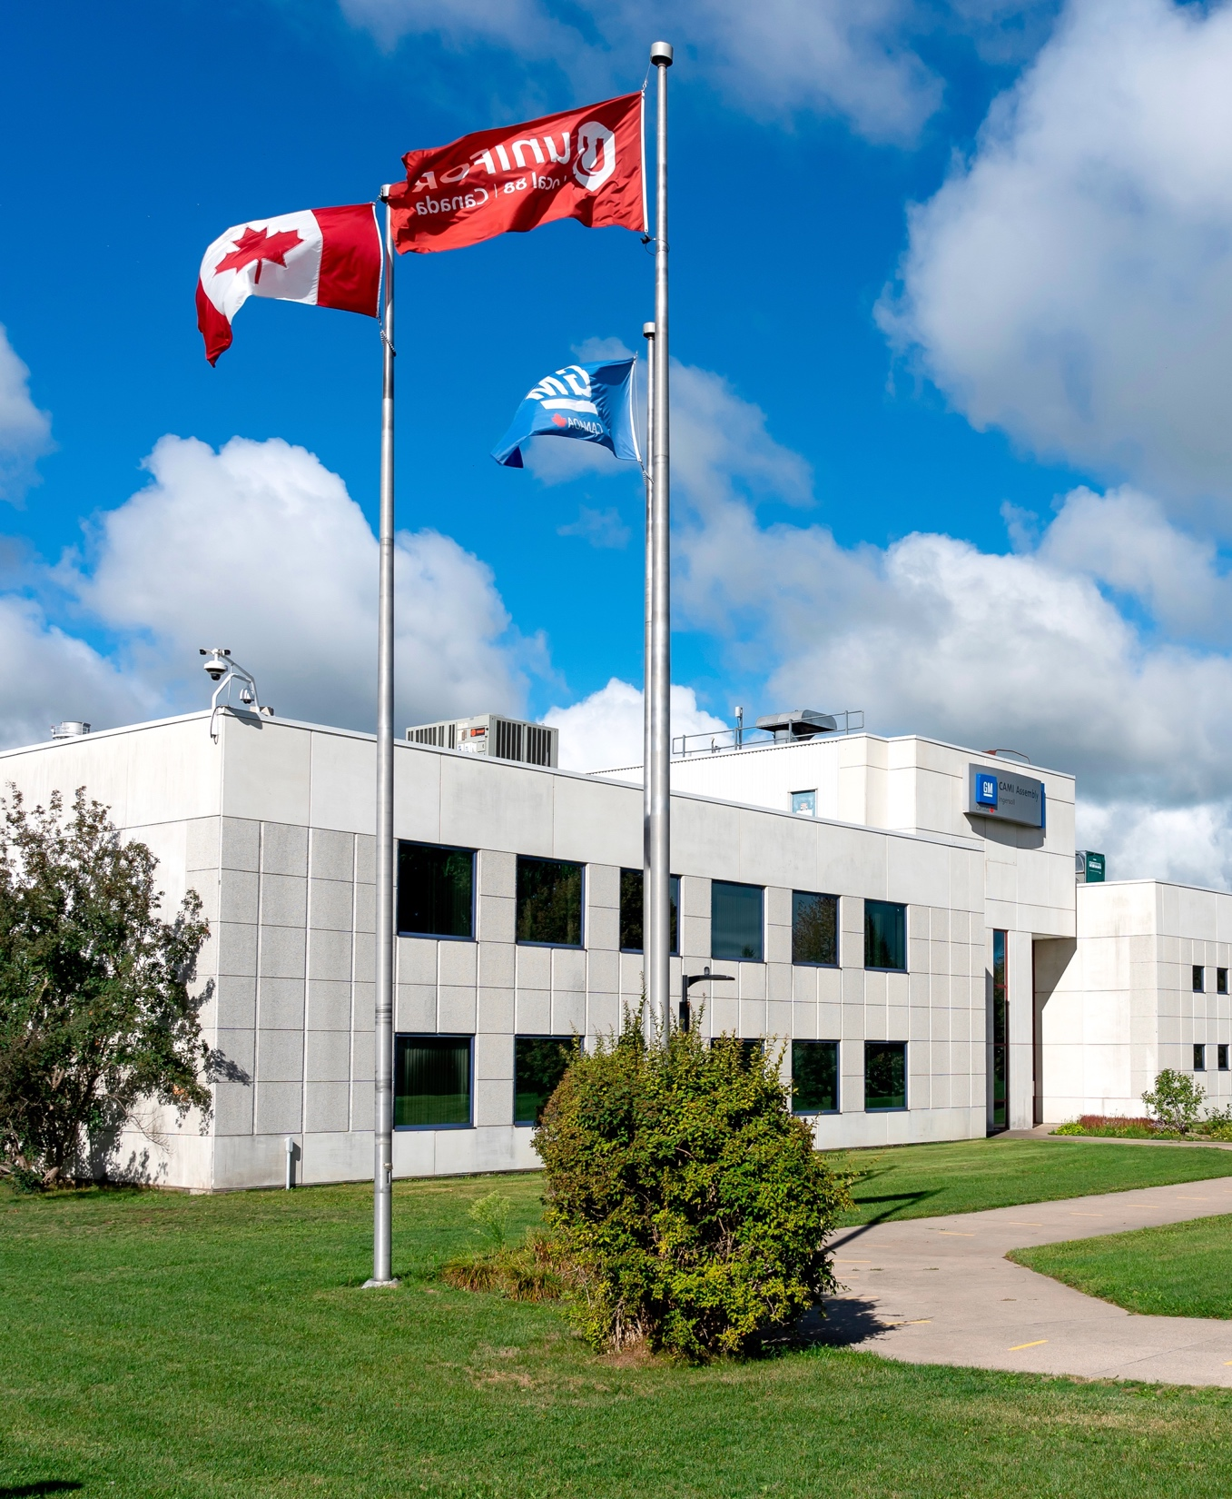


ONTARIO:
WHERE
AUTO DRIVES
THE FUTURE
AUTOMOTIVE
GIANTS
LIVE HERE
BLACKBERRY QNX
DENSO
FAURECIA
FORD
GM
HONDA
LEAR
LINAMAR
MAGNA
MARTINREA
STELLANTIS
TOYOTA

Slide 10


ONTARIO:
WHERE
AUTO DRIVES
THE FUTURE
TESLA expands into Ontario by acquiring a local battery-component company
FORD is investing $1.9B to produce electric vehicles in Ontario
BLACKBERRY QNX software will power Hyundai’s and Aptiv’s autonomous vehicles
GM announced a $1B electric vehicle plant in Ontario
FIAT CHRYSLER to invest up to $2B
in Ontario to build electric vehicles

Slide 11
AUTOMOTIVE MANUFCTURING
BY THE NUMBERS
2ND
80%
5
#1
LARGEST VEHICLE
PRODUCING JURISDICTION
IN NORTH AMERICA
(BY VOLUME)
OF PRODUCTION
VEHICLES AND PARTS EXPORTED
TO INTERNATIONAL MARKETS
OF THE WORLD’S
TOP GLOBAL ORIGINAL EQUIPMENT
MANUFACTURERS
RATED AUTO PLANT
IN THE WORLD
(J.D. POWER, 2019)
300+
700+
4
500
COMPANIES WORK IN CONNECTED AND AUTONOMOUS DEVELOPMENT AND SMART MOBILITY
PARTS SUPPLIER
ONTARIO-BASED
PARTS COMPANIES IN THE TOP 100 GLOBAL SUPPLIERS
TOOL, DIE AND
MOULD MAKERS

Slide 12
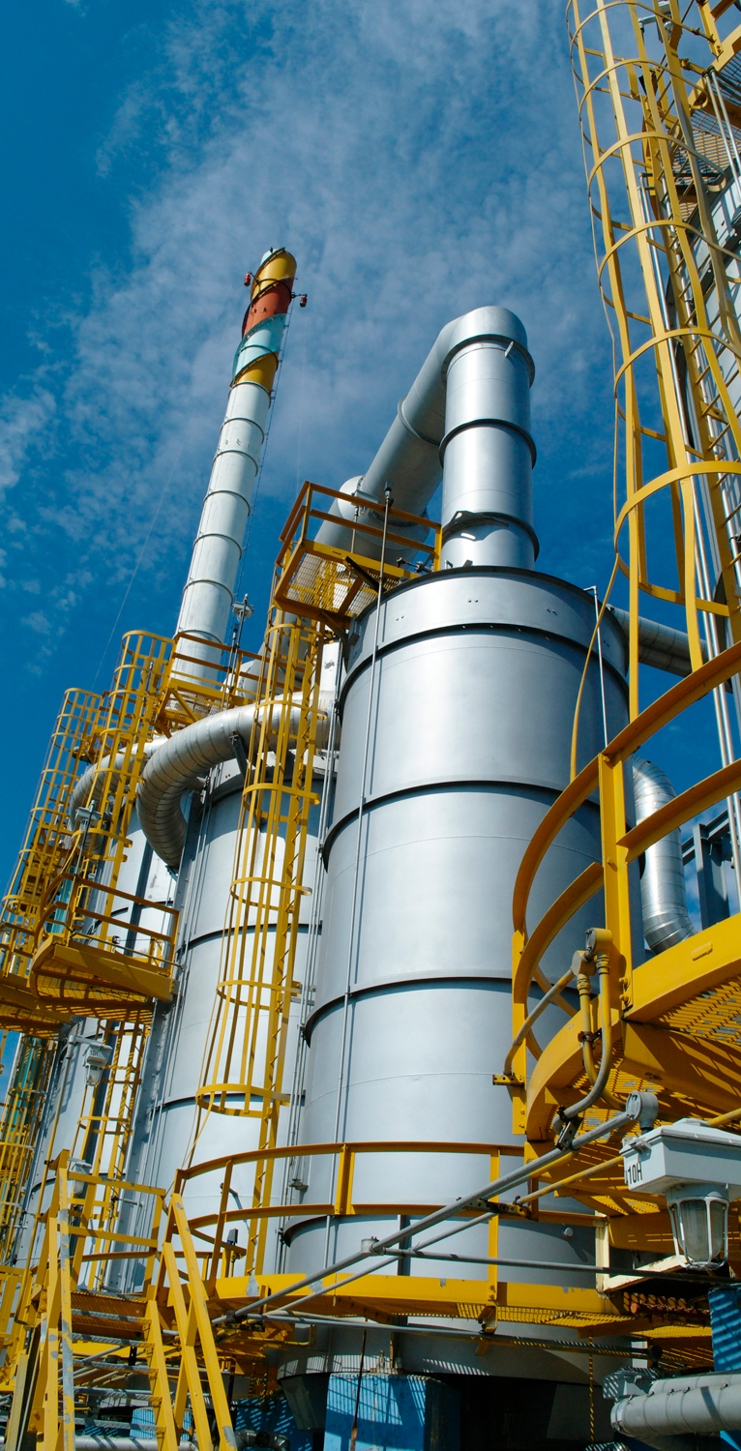

ONTARIO:
WHERE
CHEMICALS
CATALYZE
In some form or another, chemicals are used to produce virtually every product, from the cars we drive to the food we eat to the electronics we use.
Ontario is home to nine of the world’s largest chemical manufacturers. They produce everything from industrial chemicals to synthetic resins, fertilizer and formulated products to refined biofuels and petroleum.
These global giants are here because we supply them with everything they need to succeed—access to raw materials (including biomass), refineries, skills-specific talent, world-class research and commercialization centres and large established domestic and
global markets.
Our expertise in all things chemical makes us an ideal location
for your business to grow. It’s why we continue to attract new manufacturers who are drawn by our unique value propositions
and two investment-ready locations: Sarnia and Eastern Ontario.
And when it comes to safe, responsible and sustainable
chemical manufacturing, we’re proud to say we are world leaders. Our industry’s Responsible Care Initiative, created more than
35 years ago, is the global gold standard and practised in
73 countries by 96 of the world’s largest chemical producers.
WHO’S HERE IN CHEMICALS
AIR LIQUIDE
ARLANXEO
BASF
CF INDUSTRIES
DOW
DUPONT
EVONIK
IMPERIAL OIL
LANXESS
LCY BIOCHEMICAL
NOVA CHEMICALS
SHELL
SOLVAY
SUNCOR

Slide 13
CHEMICAL MANUFCTURING
BY THE NUMBERS
9
700+
$16.5B
OF THE WORLD’S TOP 15
GLOBAL
CHEMICAL FIRMS
chemical manufacturing companies
in shipments
80%
35
exported
to global
market
years in responsible
and sustainable chemical manufacturing

Slide 14
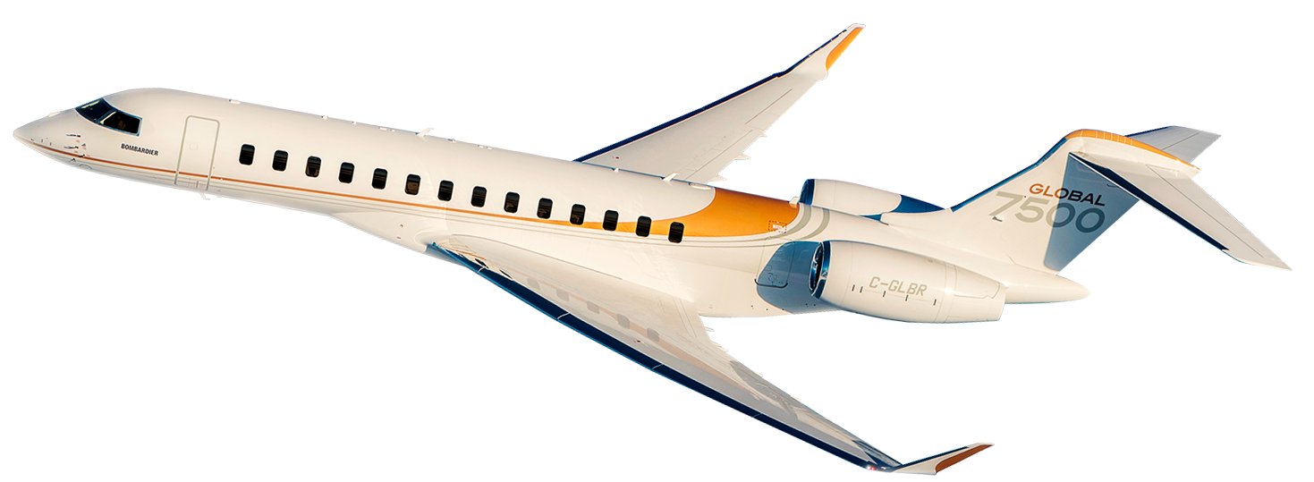

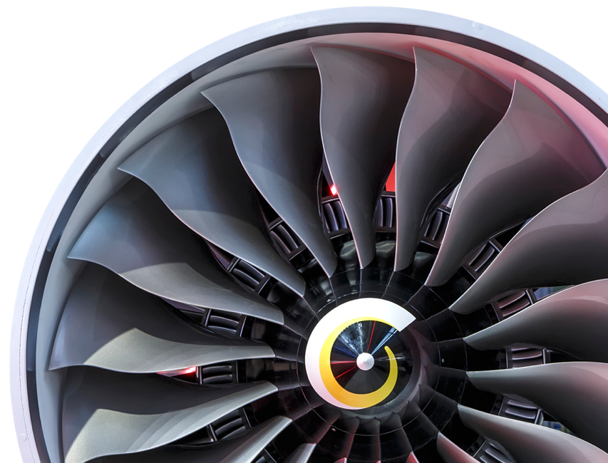
ONTARIO:
WHERE
AEROSPACE
TAKES OFF
Bombardier's Global 7500 aircraft
From the first De Havilland Beaver floatplane to Canadarm 2, Ontario has a long history of excellence in aerospace technology and production—which is why global aerospace giants and innovators have chosen to expand their operations here. We are fully equipped to help your business develop and commercialize new products and technologies that will soar above the rest.
We’re globally recognized in producing avionics, aerostructures, landing gear, MRO and modifications, aircraft engines, remotely piloted aircraft systems and space systems and satellites. And thanks to a well-earned reputation for quality, value, performance and reliability, Ontario-made parts are in virtually every passenger aircraft in the world.
It’s no secret that the coronavirus has grounded a large part of the global aerospace industry. But here in Ontario, we’re gearing up for the post-COVID-19 world—and we want your business to be a part of that resurgence.
Because talent flocks to where the action is, we continue to attract the best and brightest in the field. And innovation hubs such as Downsview Aerospace Innovation and Research are taking breakthroughs out of the lab and into the skies.
WHO’S HERE IN AEROSPACE
AIRBUS
BOMBARDIER
COLLINS AEROSPACE
DE HAVILLAND AIRCRAFT OF CANADA
DIAMOND AIRCRAFT
HÉROUX-DEVTEK
HONEYWELL AEROSPACE
L3HARRIS
LEONARDO
MDA
MITSUBISHI HEAVY INDUSTRIES
PRATT & WHITNEY CANADA
PRECISION CASTPARTS CORP
RAYTHEON TECHNOLOGIES
SAFRAN

Slide 15
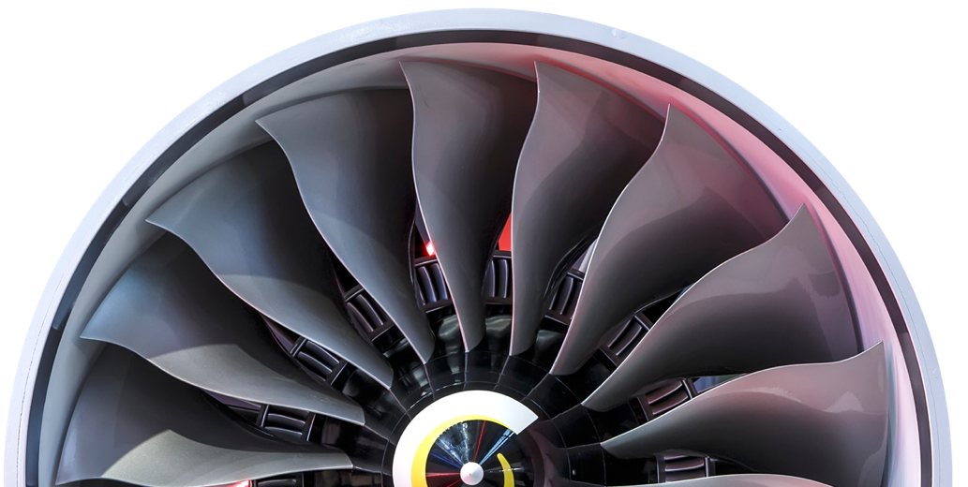
AEROSPACE
BY THE NUMBERS
93%
200+
40+
3
of Canadian
aerospace firms are exporters, well above the manufacturing average
aerospace firms
post-secondary programs in
applied aerospace, aviation and space disciplines
of the top
global landing gear companies producing full or major components

Slide 16
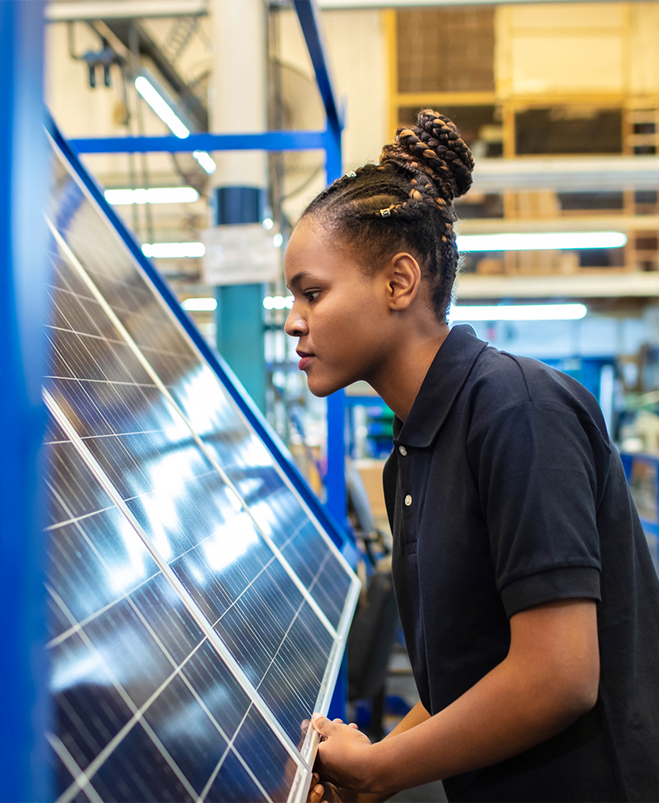

ONTARIO:
WHERE CLEAN
TECHNOLOGY
SHINES
5
It’s no secret that the world is moving toward a sustainable tomorrow, and Ontario clean technology (cleantech) companies are in the frontline. We have leaders in solar, hydrogen fuel cells, biofuels and smart energy technologies—though we’re perhaps best known for our expertise in water purification. Many of the biggest breakthroughs in water remediation have come from Ontario, including UV disinfection and membrane filtration, two of the most widely used technologies in the quest for clean water.
We are also home to the world’s first all-electric, battery-powered underground mine, eliminating greenhouse gas emissions associated with moving materials. You can be confident that by locating your business in Ontario, you are part of an ecosystem at the forefront of environmental progress.
Ontario boasts a number of world-leading research institutes and technology incubators focused specifically on cleantech, as well as some of the best R&D incentives to be found anywhere. Our latest initiative? EaRTH District—a collaboration between the University of Toronto and Centennial College that’s advancing the cleantech sector’s development through research, academic programming and commercialization.
5 INNOVATIVE
ONTARIO
COMPANIES ON THE
2021 GLOBAL
CLEANTECH 100
ECOBEE
Smart Thermometers
GAN SYSTEMS
Power Transistors
LI-CYCLE
Lithium Battery
Recycling
OPUS ONE SOLUTIONS
Renewable Power
Efficiency
PARITY
Energy Efficiency

Slide 17
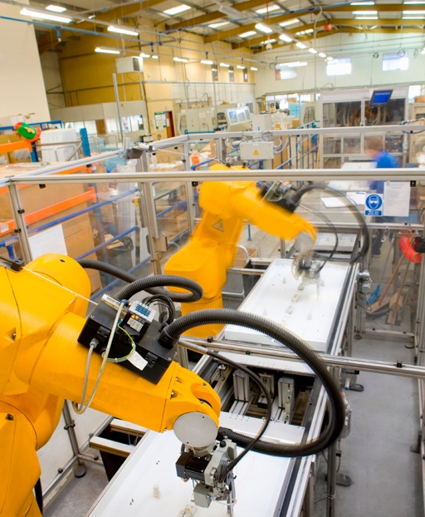


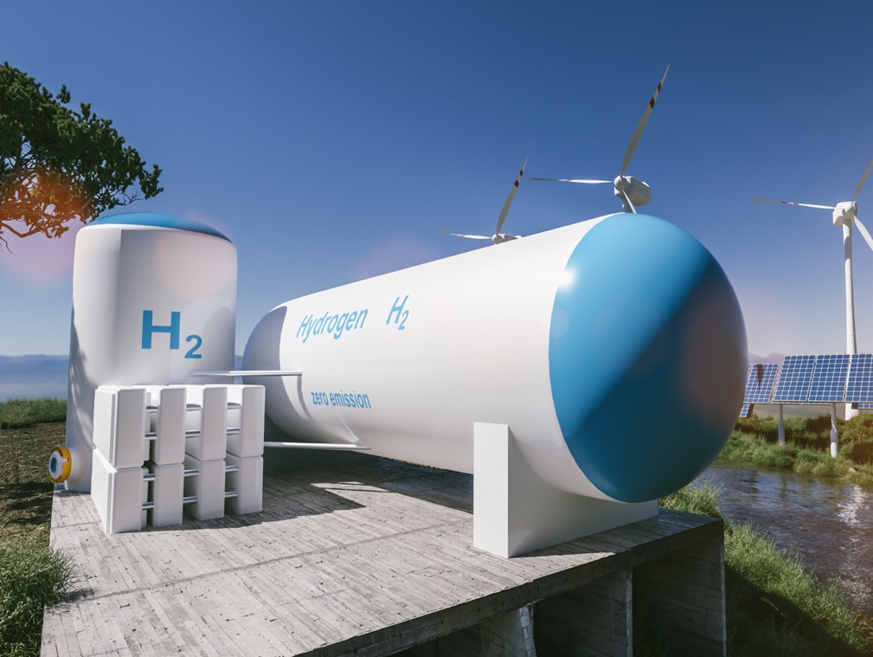
ONTARIO:
WHERE CLEAN
TECHNOLOGY
SHINES
WHO’S HERE IN
CLEANTECH
CUMMINS
ECOBEE
GE
GREENFIELD GLOBAL
GREENMANTRA TECHNOLOGIES
HATCH
HYDROSTOR
POND TECH
PYROWAVE
SCHNEIDER ELECTRIC
SILFAB SOLAR
SUEZ WATER TECHNOLOGIES & SOLUTIONS
TROJAN TECHNOLOGIES
VEOLIA WATER

Slide 18

CLEANTECH
BY THE NUMBERS
5,000
#1
$5.8B
companies
largest
cleantech sector
in Canada
worth of exports
$25.4B
134,000
100
5
contribution
to GDP
employees
water technology incubators
Ontario companies on the 2021 Global Cleantech 100

Slide 19


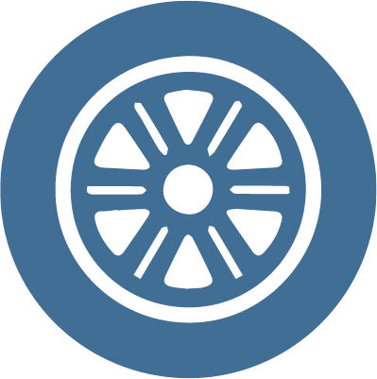

WHY INVEST IN ONTARIO?
ACCESS A PREMIER TALENT & INNOVATION ECOSYSTEM
EDUCATED
70% of Ontario adults possess a post-secondary education—
a rate higher than any OECD country
ACADEMIC LEADERSHIP
World-class academic and research institutions
INCUBATOR HUB
Largest concentration of
innovation incubators
IT CLUSTER
2nd-largest IT cluster
in North America
R&D PROGRAMS
Significant after-tax
cost savings
IMMIGRATION SUPPORT
Ontario Immigrant
Nominee Program
BENEFIT FROM COMPETITIVE
BUSINESS COSTS
TAXES
Corporate tax rates
are below the G7 average
LABOUR
High-quality talent at
up to 50% less than top
U.S. tech hubs
EMPLOYER-PAID
HEALTH CARE
Almost 1/3 the cost of comparable U.S. regions, thanks to universal
health care
EXCHANGE RATE
Favourable exchange
rate, typically 25% less than the U.S. dollar
RECEIVE CUSTOMIZED
BUSINESS SUPPORT
CUSTOMIZED SERVICE
Personalized support from Invest Ontario—our province’s new investment attraction agency
REGULATORY SUPPORT
Regulatory environment
that is easy to navigate. Canada is the 2nd-best
location among the
38 OECD countries to start a business
TAILORED INSIGHTS
Business intelligence and market opportunities
LOCATION SUPPORT
Site selection and land
planning services
PARTNERSHIPS
Private and public sector partnerships
TAKE ADVANTAGE OF
GLOBAL MARKET ACCESS
TRADE PARTNERSHIPS
Trade agreements with
50 countries around
the world
EASE OF TRANSPORT
4 international and
300 regional airports,
250,000 km of roads and highways, a dozen border crossings and the 6th most internationally connected airport in
the world
MARKET PROXIMITY
Access to hundreds of millions of people within a day’s drive
THRIVE IN A DIVERSIFIED & GROWING ECONOMY
DIVERSIFIED ECONOMY
Strong representation in all sectors and industries
ECONOMIC POWERHOUSE
Ontario is Canada’s
economic engine
ECONOMIC STABILITY
Stable political and
economic climate
ECONOMIC SUCCESS
Excellent GDP
growth rate
EXPERIENCE AN EXCELLENT QUALITY OF LIFE
QUALITY OF LIFE
Ranked among the best places to live and work
in the world
DIVERSE POPULATION
Ontario celebrates multiculturalism, representing 150 countries from every corner of the world
SAFETY & SECURITY
Quality health care, transportation
infrastructure and
social support
TOURISM & ENTERTAINMENT
World-class arts and
culture attractions

Slide 20
Advanced Manufacturing in Ontario, Canada
WHAT’S THE NUMBER ONE REASON MANUFACTURERS CHOOSE ONTARIO?
Access to a pipeline of highly skilled, educated and diverse talent.
THE
INTELLIGENT
CHOICE
By locating your business in Ontario, you can tap into one of the best-educated workforces in the G7. We also encourage companies to work with colleges and universities to develop programs that produce workers with the specific skills they need to succeed in today’s innovation economy. That means you will have the first pick from a talent pool with the most up-to-date industry qualifications.
Our friendly approach to immigration also means you can fast-track visas for highly skilled workers from anywhere in the world via the federal government’s Global Skills Strategy Program, which offers work permits within 10 business days.
Here, you’ll have access to the best and brightest talent—whether transplanted or homegrown.

Slide 21
THE
INTELLIGENT
CHOICE
SOME OF THE WORLD’S
BEST AND BRIGHTEST
The most available qualified engineers
in the G7
The highest concentration of entrepreneurs
in the world
A network of highly ranked universities and colleges that guarantees uniformly well-educated graduates trained to think outside
the box—including 55,000 STEM grads
per year
Extensive co-op and internship programs
that produce industry–ready workers
CHOOOSE TO CALL
ONTARIO
HOME

Slide 22

+
THE
INTELLIGENT
CHOICE
THE R&D
ADVANTAGE
IT ADDS UP:
ONTARIO’S R&D
TAX CREDIT
DOING RESEARCH IN ONTARIO PAYS.
LITERALLY.
+
With the business of manufacturing changing—and fast—harnessing the power of advanced technologies is the key to your company’s success. Ontario can provide a critical edge—one that many global leaders have already discovered.
We start with research excellence. Scientists at
centres all across Ontario are conducting world-leading research in artificial intelligence, computing, advanced materials, robotics, lasers, optics, information and communications, microelectronics, energy and sustainable technologies. All areas of interest to manufacturers like you.
Our R&D tax credits are among the most generous in the world—by performing
R&D in Ontario, small and
medium-sized manufacturers can
SAVE UP TO 50%
on their after-tax expenditure.

Slide 23
THE
INTELLIGENT
CHOICE
INCUBATING AND ACCELERATING
WORLD-CHANGING IDEAS
Our network of incubators and startup centres accelerate global commercialization.
A WIDE RANGE OF RESEARCH
AUTONOMOUS VEHICLE INNOVATION NETWORK
Autonomous technologies and smart mobility solutions
CENTRE FOR CATALYSIS RESEARCH AND INNOVATION
Catalysis, focus on energy and renewable feedstocks
FRAUNHOFER PROJECT CENTRE FOR COMPOSITES RESEARCH
New lightweight materials and advanced manufacturing processes
UNIVERSITY OF TORONTO ROBOTICS INSTITUTE
Robotics for manufacturing
VECTOR INSTITUTE FOR AI
Artificial intelligence, focus on machine and deep learning
ONTARIO CENTRE OF INNOVATION
Commercialization of academic intellectual
property and adoption of emerging technologies
SOUTHERN ONTARIO NETWORK OF
ADVANCED MANUFACTURING
Collaboration network turning innovation into commercialization
COMMUNITECH ( WATERLOO )
A 24-year history of building successful companies
VELOCITY ( WATERLOO )
The world’s largest free startup incubator
MaRS ( TORONTO )
The world’s largest urban innovation hub
DMZ ( TORONTO )
The top university business incubator in North America
GLOBAL CYBERSECURITY RESOURCE ( OTTAWA )
A novel cybersecurity accelerator
NORCAT ( SUDBURY )
Supports Ontario’s reputation as a leader in the global mining market
VINELAND RESEARCH AND INNOVATION CENTRE ( NIAGARA )
World-class research centre dedicated to horticultural science
and innovation
THE FORGE ( HAMILTON )
Serving novel and scalable startups

Slide 24
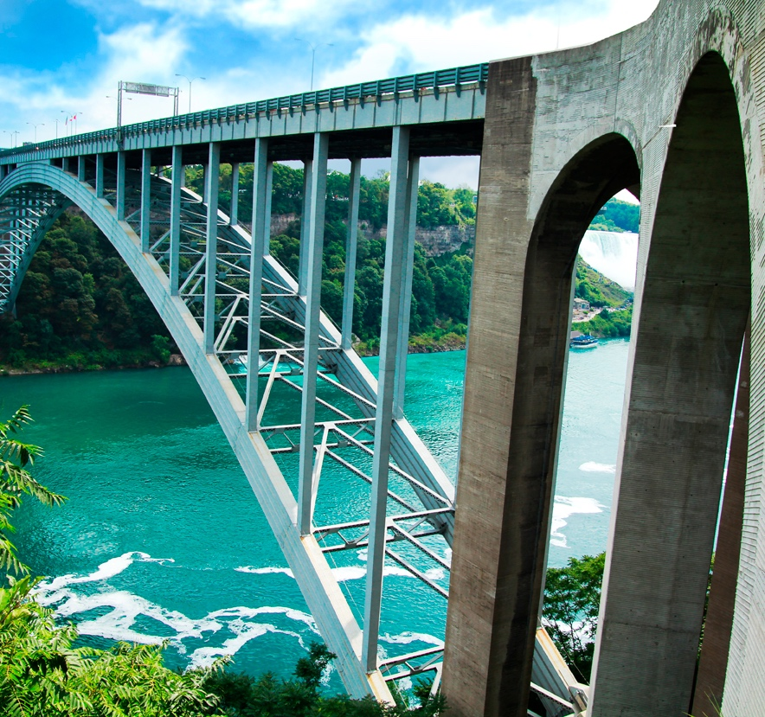
THE LOW
COST OF
DOING
BUSINESS
By locating in Ontario, you’ll save on some of your biggest business costs. That’s money you can use for further investments, innovation and growth.
Start with the cost of talent. The convergence of manufacturing with advanced technologies has drawn attention to Ontario’s talent advantage. Comparable high-quality talent found in top U.S. tech hubs such as Boston or New York is available to you here at a fraction of the cost and in some cases up to 50% less.
Then, there are our corporate tax rates—which are second only to Ohio when compared with other comparable American manufacturing centres.
And thanks to our universal health care system, annual employer health costs for a typical firm are almost one-third of comparable U.S. regions.
Our utility costs rank favourably with our U.S. peers. By operating here, you can be part of the global shift to a low-carbon economy.
As for the cost of living, Ontario cities compare favourably with their U.S. peers, and less money buys more living space, according to the median multiple affordability index.
The Rainbow Bridge at Niagara Falls, which connects Ontario to the United States.

Slide 25
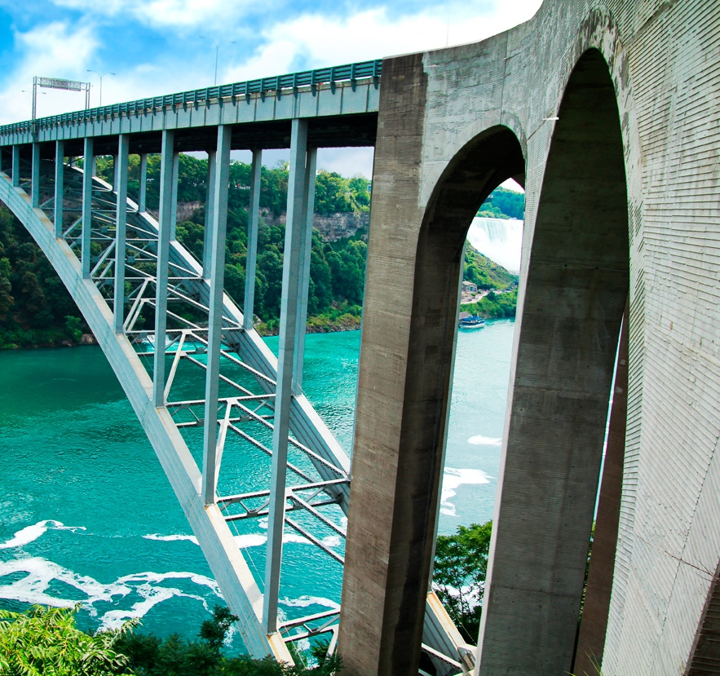
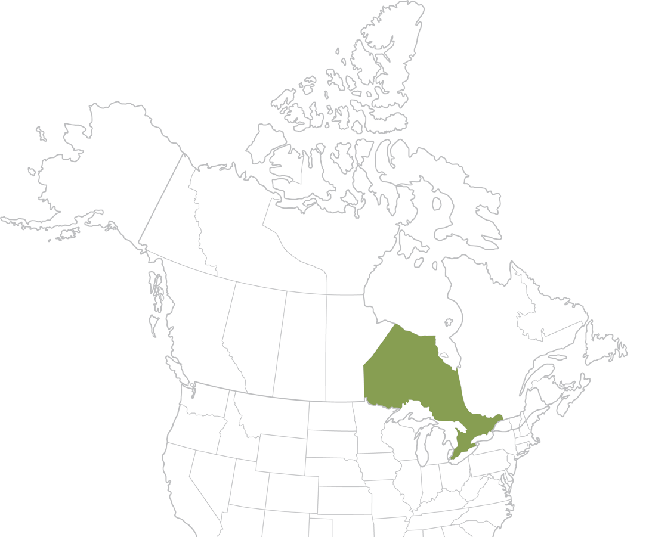
LOCATION
LOCATION
LOCATION
In today’s global economy, we know location matters to your business. Ontario provides the ideal base for manufacturers eager to enter the lucrative North American market. And we’re well situated for doing business with Europe and Asia as well.
From auto to aero, chemicals to cleantech, information technology to life sciences, we’re host to a burgeoning list of companies. And, because they’re here, they’re fully integrated with U.S. suppliers and customers. As part of the USMCA (the United States-Mexico-Canada Agreement), companies based in Ontario have tariff-free access to one of the world’s largest markets via our sophisticated and extensive transportation network.
We have same-day business access within North America and Europe and an evening overlap with Asia, thanks to the province’s four international airports and robust rail network. Our global, cultural and business affinities smooth the way for international trade, investment and partnerships—that’s a definite advantage for your business when you’re selling to
the world.

Slide 26
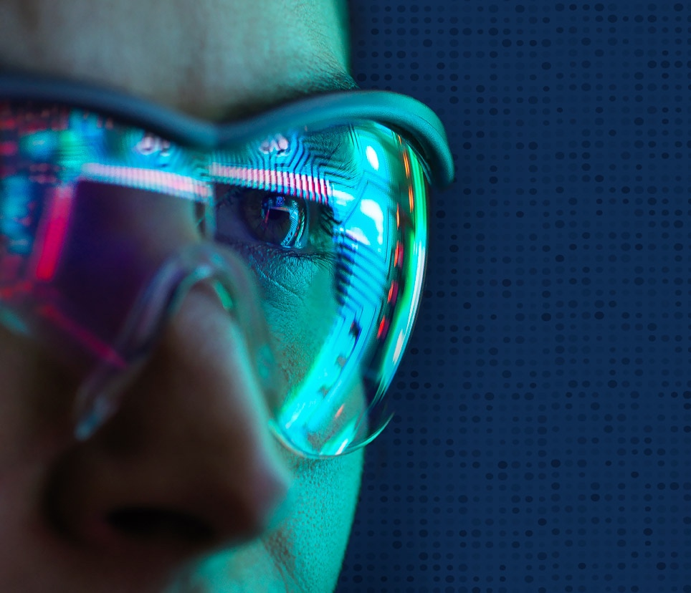
TACKLING THE WORLD’S GREAT CHALLENGES THROUGH ADVANCED MANUFACTURING
When you think about the future of your manufacturing business, you should think Ontario. The province is at the forefront of industry 4.0, using technology to take on some of the world’s biggest challenges. Whether it’s mitigating climate change through the use of electric vehicles, rebuilding the aerospace industry in a post-pandemic economy, or creating sustainable packaging to reduce waste, Ontario has the technology and talent to address the needs of today—and tomorrow—head-on.
Ontario is at the precipice of greatness, with no plans of slowing down. We are finding opportunity in the unpredictable, developing breakthroughs and making the impossible a reality.
That’s why companies with bold ideas are flocking to the province. If you’re not already tapping into our manufacturing expertise, you probably should be.
Rebuild, recover and reimagine
your business in Ontario, Canada.

Slide 27
ONTARIO COMPANY’S
SAFE SPACE TECHNOLOGY
A GAME-CHANGER
Keeping people safe from deadly viruses is on everyone’s radar worldwide. Toronto-based Kontrol Technologies, a leader in energy management, air quality and continuous emission monitoring, has developed a technology to detect airborne viruses like COVID-19 in real-time. Its revolutionary BioCloud device continuously monitors the air in places where people gather, including schools, offices, hospitals, public transportation and manufacturing facilities. When it detects the presence of a pathogen, it sends out an alert via the cloud or local intranet. Kontrol Technologies, which will be producing 20,000 units a month for global markets,
was able to get BioCloud to market quickly, thanks to the government’s Ontario Together Fund. It was created to help businesses like Kontrol Technologies provide innovative solutions to diseases, including COVID-19.
WE WANT TO THANK THE ONTARIO GOVERNMENT FOR THEIR SUPPORT FOR COMMERCIALIZING AND ACCELERATING PRODUCTION OF BIOCLOUD. WE’RE PROUD TO BE A MADE-IN-ONTARIO TECHNOLOGY.
Paul Ghezzi, CEO
Kontrol BioCloud

Slide 28
Students [ in Ontario ]
are pushing the envelope in science, engineering and other fields.
ONE OF THE MOST INTERESTING STARTUP HUBS IN THE WORLD.
Sam Altman
Y Combinator
Bill Gates
Ontario gives us
access to problem-solvers with different sets of engineering skills
We can do development that no one else can.
John Comar
Automotive Centre of Excellence, Oshawa
Grant Courville
BlackBerry QNX

Slide 29



LEARN MORE
InvestOntario.ca
ONE CALL. ALL THE ANSWERS.
+1 416-313-3469
FOLLOW US
company/investontario
@investontario

